Slide 1
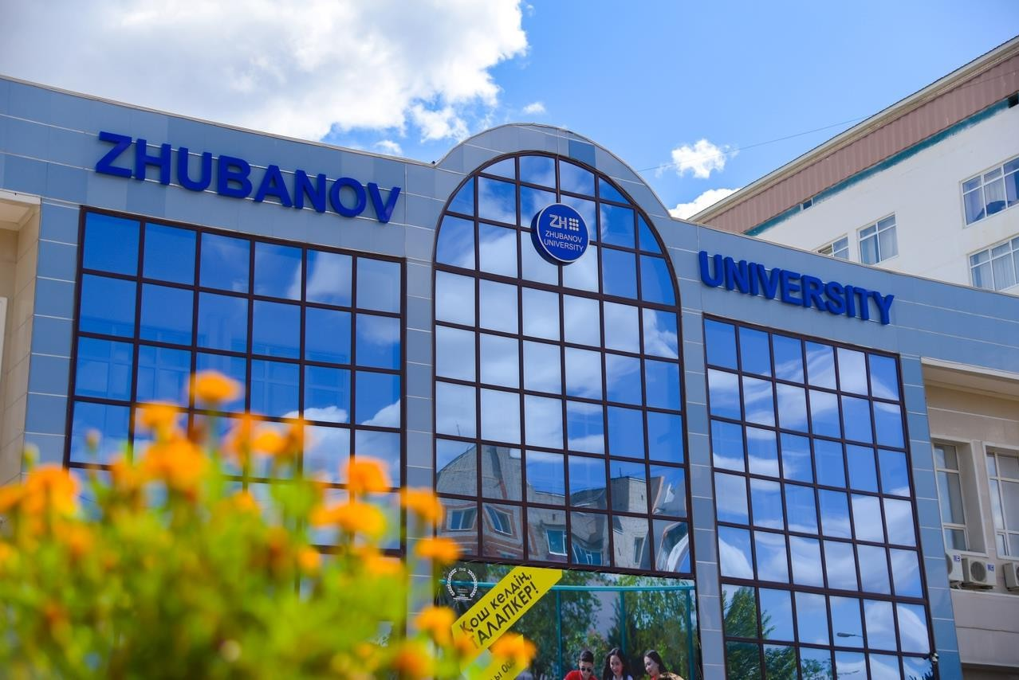

K. Zhubanov Aktobe Regional University
Aktobe, Kazakhstan

Slide 2






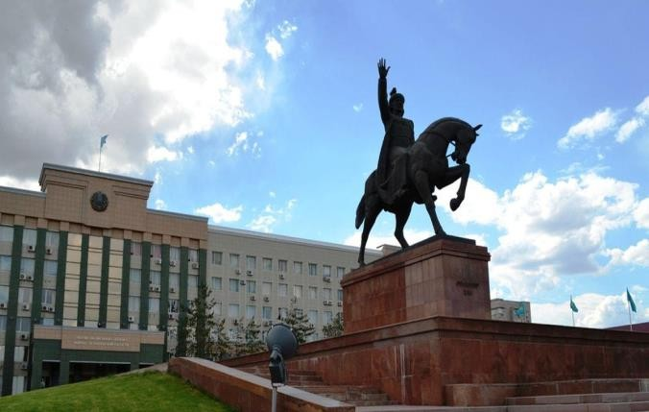
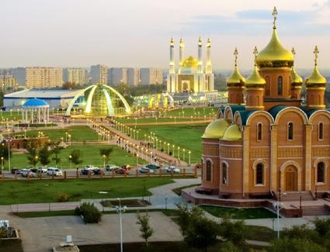
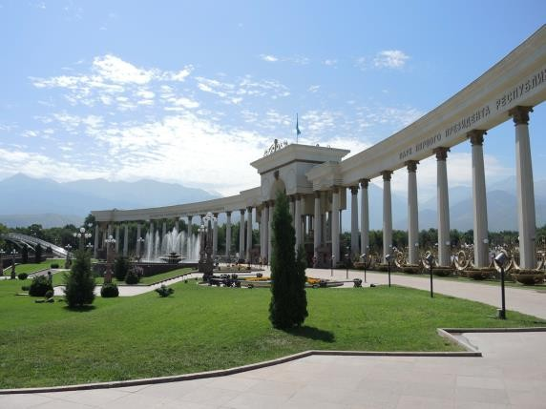
AKTOBE, KAZAKHSTAN
Large industrial area
Center of metallurgical, oil and gas, and chemical industries
Total Population
869 637
Youth
202 685

Slide 3
UNIVERSITY MISSION/ VISION AND HISTORY
M
Formation of a qualified specialist and a “perfect personality” who has absorbed national values
V
A multidisciplinary classical university that provides
the western region specialists and has science.
2001
of Kazakhstan with qualified become the core of applied
1935
Aktobe Pedagogical Institute established.
1966
Pedagogical
2018
Aktobe
K.Zhubanov Aktobe University was awarded state status.
Community College and Children's development center founded.
2019
Reorganization into NJSC “K. Zhubanov Aktobe Regional University.“
2023
Zhubanov University is in top 4 among universities in Kazakhstan.
Institute was reorganized.
1945
The Institute was named after the honored worker of culture of the Kazakh SSR, poet Nurpeis Bayganin.
1990
Aktobe Pedagogical Institute was named after the first professor in
2009
Bologna Charter was signed.
linguistics in Kazakhstan
Kudaibergen Zhubanov.
1996
1947
Kazakh Women's
2013
Transformation into K.Zhubanov Aktobe Regional State University
The
K.Zhubanov Aktobe Pedagogical Institute was transformed into K.Zhubanov Aktobe University
Pedagogical Institute founded on the basis of the N.Baiganin Aktobe Pedagogical Institute.

Slide 4
















UNIVERSITY ECOSYSTEM
6 campuses
Health Center
Innovation parks
4 Student Dormitories
2 Sports Centers
5 sports fields
Students hall
Zhubanov Cinema
Youth Palace
More than 50 classrooms, specially equipped classrooms, IT, STEM, and recording Web Labs
5 conference rooms (capacity for 80-250 seats)
ARU Store
Start-up Academy
Мedia Center
Atrium Exhibition Halls
Children Development Center
Choreography hall
Student Service Center

Slide 5
ACADEMICS
Academic environment of the Zhubanov University complies with the principles and values of the Bologna Declaration, and the requirements of regulatory state program documents of higher education sector.
Faculties
University released 100 000+ graduates
Faculty of History
Faculty of Pedagogy & Management in Education
Faculty of Professional & Creative Arts
Faculty of Natural Sciences
Technical Faculty
Faculty of Physics & Maths
Philological Faculty
Faculty of Economics & Law
Faculty of Foreign Languages
Heriot-Watt International Faculty
With over 100+ academic degree programs Aktobe Regional University offers:
6 Ph.D. programs
46 Graduate degree programs
69 Undergraduate degree programs
12 programs in Community College
Total number of students: 13 500 students

Slide 6

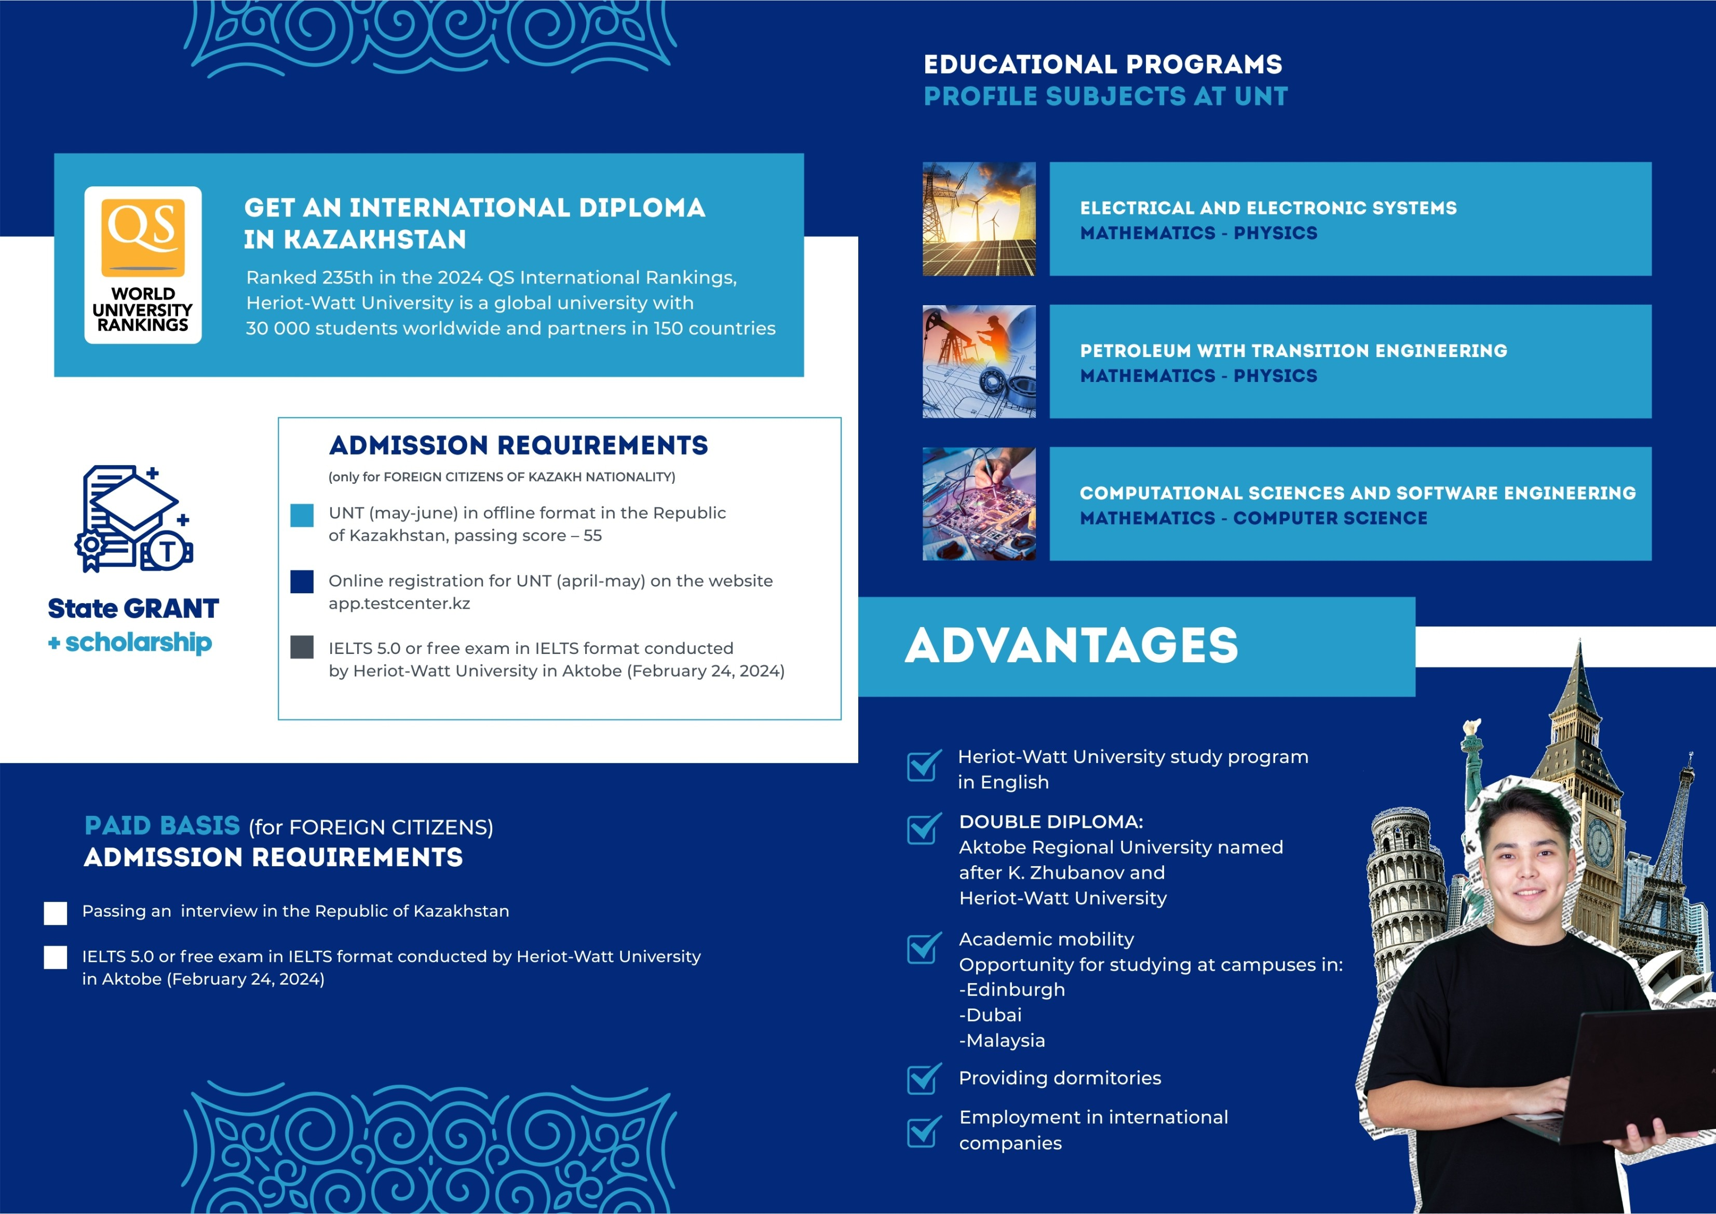



HERIOT-WATT INTERNATIONAL FACULTY
The history of the opening of the branch of
Heriot-Watt University in Aktobe is a signiﬁcant development in line with the directive of the Head of State, Kassym-Jomart Tokayev, aimed at reforming the higher education system to meet the demands of the economy. This branch was established on the premises of Aktobe Regional University, one of the largest universities in the western region of Kazakhstan.
Specialties:
6B06107 - Computer Engineering
6B07108 - Electric Power Industry
6В07209 - Petroleum Engineering &
Energy Management
Since September 2023, more than 300 students have been accepted for three undergraduate programs with English as a language of instruction.

Slide 7
ACADEMICS
Applicability of employee-involvement approach in the development of educational programs:
138 representatives of various enterprises and organizations of the Aktobe region participated to create 400 disciplines across the university.
Projects implemented in academic process:
  Professional Certification
  Students of some academic programs get paid internships at the expense of enterprises with the condition of further employment
  University department branches (82 branches are created on the basis of various enterprises and educational organizations
  Multilingual education (7 majors of "Education" direction)
  Elements of dual education (introduced for 114 disciplines in 35 academic programs)
  Academic trajectories (57 trajectories in 30 academic programs)

Slide 8








INTERNATIONAL RANKINGS
QS World
Ranking: EECA (Emerging Europe & Central Asia) University Rankings
351
551-600
QS Central Asia University Rankings 2023
29
"ATAMEKEN" NCA rating
2023
TOP 10
26th educational programs
6B01201-Preschool Education 6B01501-Mathematics 6V01504-Chemistry
6В01511-Geography-History 6B01601-History
6В01704-Russian language and literature (EFL)
9

Slide 9

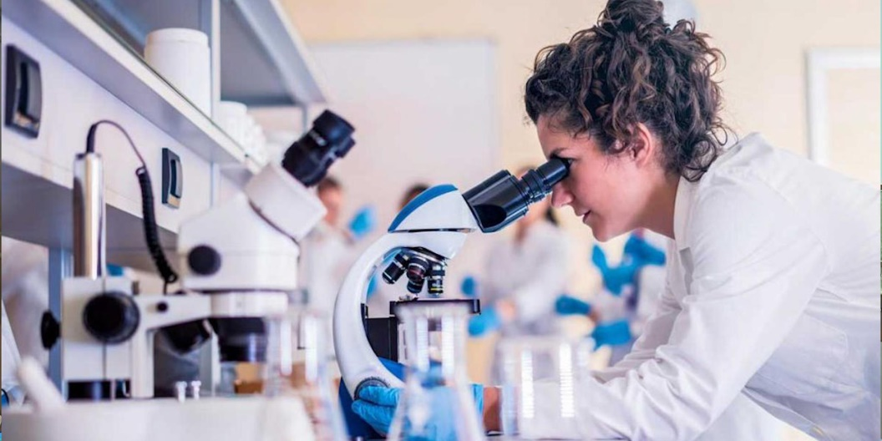

“500 researchers” project as part of “Bolashak” program
16 teaching staff – 7 countries
Michigan State University, USA (1)
University of Minnesota, USA (6)
Heriot-Watt University, Great Britain (2)
Lomonosov Moscow State University, Russia (2)
University of Reading, Great Britain (1)
Sofia University “St. Kliment Ohridski” (2)
Universities:
Directions:
Management in the field of Education
Research in Education
Law
Philology
Environmental ecology
Information (cyber) security
University of Leeds, Great Britain (2)

Slide 10
INTERNATIONAL COOPERATION
Agreements – 123 (22 countries)
Grant Programs and Projects
Universities included in the TOP -500 8
ERASMUS + PROGRAM 4
ORHUN EXCHANGE (2024)
Other academic exchange 20
AMERICAN COUNCIL
EXPERTISE OF SENIOR GERMAN EXPERTS INTERNATIONAL CREDIT MOBILITY
RITA REGION RENOVATION
5 programs
21 participants
3 experts
1 project
Educational and Cultural Center “QAZAQ ELI”
Language Centers
BYDGOSZCZ UNIVERSITY OF ECONOMICS
(POLAND, 2018)
CONFUCIUS INSTITUTE
KOREAN LANGUAGE CENTER
CENTER FOR POLISH LANGUAGE AND CULTURE
TOEFL CENTER
UNIVERSITY OF KASTAMONU (TURKEY, 2019)

Slide 11


INTERNATIONAL UNIVERSITY PARTNERS
Kastamonu University, Turkey
St. Petersburg State University, Russia
Beijing Institute of Technology, China
Jiangxi University of Finance and Economics, China
China University of Petroleum, China
Rzeszow University of Technology, Poland
Shota Rustaveli Batumi State University, Georgia
Gazi University, Turkey
Ataturk University, Turkey
Marshall University, USA
Yili Normal University, China
Tashkent Institute of Textile and Light Industry, Uzbekistan
Uzbek State University of Physical Culture and Sports, Uzbekistan
Pomeranian University in Slupsk, Poland
Kyrgyz National Agrarian University named after K.I. Scriabin, Kyrgyzstan

Slide 12



























76
ACADEMIC MOBILITY AND INTERNATIONAL STUDENTS
70
Russia
USA
Lithuania
Georgia
45
2023
2022
Poland
Turkey
2
Italy
2021
76 students
2
1
TOP – 4 SCHOOLS
91
6 countries
Foreign Languages Economics & Law
Professional & Creative Arts Physics & Math
International students
84 undergraduates
7 graduates

Slide 13


INTERNATIONAL JOINT PROJECTS
The University has won grants among 4 Kazakh universities for the promotion of key educational programs in ecology and environmental sciences in the universities of Kazakhstan (Advancing Key Curriculums of Ecology and Environmental Sciences in Rural Kazakhstan Universities).
The agreement on joint projects with the Director of Innovation and External Relations of the EduCluster Finland group of the University of Jyväskylä (Finland) with David Marsh.
The University jointly with the universities of Central Asia won a grant in accordance with the goals of UNICEN for the modernization of educational programs in Central Asia - Climate action and Sustainable Development ("Modernizing Curriculum").
Initiated a partnership with the University of Minnesota (USA) to enhance qualifications through a scholarship from the American Council and the Bolashak Program.
Project EMBICA - Establishment of Master Program in Bioinformatics at Aral Sea Basin Universities: 2 universities of Kazakhstan, 2 - Uzbekistan and 2 - Europe (application submitted).
Professional Development program to improve teacher education jointly with HAMK University, Finland (financed by World Bank). This project is aimed at improving the model of pedagogical education and the development of new curriculums for pedagogical specialties in Kazakhstan.
Fullbright Scholars Program by US Embassy – 1 scholar to give lectures at the Philological Faculty in 2022-2023 acad.yr.

Slide 14

INTERNATIONAL SCHOLARS
2023 - 2024 academic year
Countries
82 scholars - 10 % from total number of teaching staff
Forms of interaction:
lectures, seminars;
joint research projects;
Master’s and PHD supervision
Finland
Great Britain Scotland
Singapore
South Korea
USA
China
Canada
Estonia
South Korea
Latvia
Turkey
Russia
India
Poland
Czech Republic
Hungary
Uzbekistan
Foreign Scholars Program
39
Scholars with high h-index
3-10
11-20
21-30
H-INDEX
17 scholars 17 scholars 1 scholars
41-50
51-65
2 scholars
2 scholars

Slide 15

KEY AREAS OF RESEARCH
Zhubanov University expertise across faculties and schools is based on deep disciplinary
knowledge. There are significant capabilities in several research areas:
Physics and Materials Science
Engineering (Mechanical and Chemical)
Biological Sciences
Chemical Sciences
History and Archaeology
Language, Communication and Culture
Mathematical Sciences
Geography and Tourism

Slide 16

PARTNERSHIP WAYS
Exchange of researchers
Student exchange
Faculty exchange for teaching and research activities
Staff members exchange for experience sharing
Joint double degree programs
Joint research programs
Update/modification of academic programs

Slide 17
THANK YOU!

Slide 18

Attachment:
EXAMPLES OF RESEARCH LABORATORIES

Slide 19
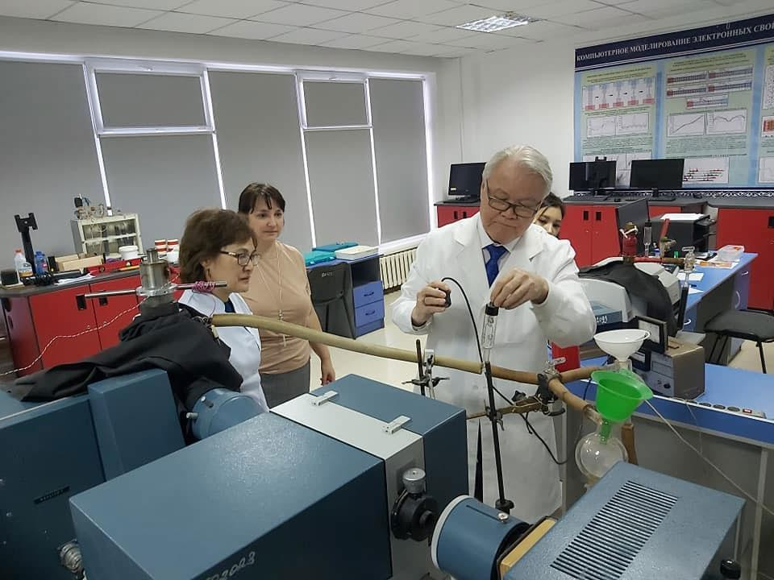
“MATERIALS SCIENCE AND RADIATION” RESEARCH CENTER
A research center was established in 1984 based on the initiative of Professor Shunkeev, to study the nature of luminescence and the mechanisms of radiation defects formation in alkaline halide crystals (ALC).
With the direct support of foreign scholar Lushchik Cheslav Bronislavovich, the laboratory clarified its scientific direction and conducted experimental equipment to ensure the recording of absorption, luminescence and thermoactivation spectroscopy, as well as the recording of ionic conductivity and thermocouple depolarization currents of crystals while reducing the symmetry of the lattice.
The universal cryostat, developed on the basis of the Research Center, was deeply studied in the laboratory of the Institute of Physics, University of Tartu, Estonia.

Slide 20
MAIN DIRECTIONS OF “MATERIALS SCIENCE AND RADIATION”
RESEARCH CENTER
Experimental study of absorption, luminescence and thermoactivation spectroscopy, as well as methods for recording ionic conductivity and thermotranslated depolarization currents of crystals while reducing the symmetry of the lattice.
Theoretical study of the processes of self-capture of electronic excitations in alkaline halide crystals to reduce the symmetry of the lattice.
Computer modeling of the mechanisms of radiation defects in alkaline halide crystals
while reducing the symmetry of the lattice.
Theoretical research and computer modeling of current transport and fluctuation superconductors in weakly connected superconductors.
Development of modern geological mapping technology for diatomite reserves in Mugalzhar district of Aktobe region (Zhalpak area).

Slide 21
RESEARCH GRANTS WON BY “MATERIALS SCIENCE AND RADIATION”
RESEARCH CENTER
2020-2021 "Technology of electrohydraulic enrichment of natural diatomaceous
earth"
2020-2022 "Effect on the radiation relaxation of electronic excitations to improve the luminescent characteristics of functional materials based on alkaline halide crystals."
2020-2022 "Study of the quantum transport characteristics of nanosystems with unique electrical and magnetic properties."
2020-2023 "Experimental study of the mechanisms of luminescence in case of activated KI, RbI and CsI crystals by cation-homologues and low-temperature deformation."
2020-2023 "Spectroscopic study of functional materials based on perovskites and
garnets mixed with Ln2 +, Ln3 +, Ln4 +".

Slide 22
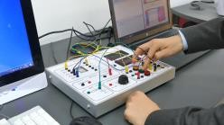
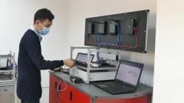
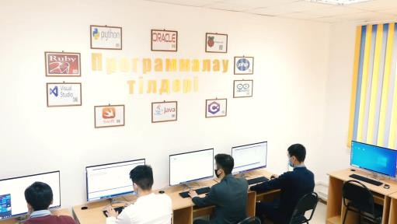
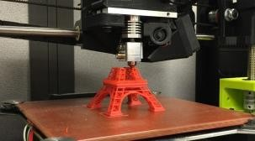
INNOVATION PARK LABORATORIES
Laboratory "Computer Networks"
Laboratory "Fundamentals of Programming"
Laboratory "3D modeling"
The laboratory is intended for conducting laboratory and practical work on the disciplines such as "Computer Networks", "Modern Communication Networks", "System Administration of Operating Systems".
Laboratory equipped with modern computers and monoblocks, is intended for conducting laboratory and practical work on the disciplines such as "Development of software in Visual Studio", "Language programming C#", "Development of software Python", "Development of software Java".
Laboratory is intended for conducting laboratory and practical work in the disciplines such as "3D modeling", "3D modeling technology" with the aim of gaining experience and skills in the field of 3D modeling in 3DS Max, Blender 3D, etc.
The laboratory is equipped with modern computers with the possibility of connection to the Internet, educational equipment "Wireless computer networks", "Installation and adjustment of cable networks", "Sensory networks ZigBee", intended for the conduct of laboratory-practical work, construction and administration of switched local area networks, basic knowledge and practical skills in the configuration of control elements of wireless networks ZigBee.
On the basis of the "3D modeling" extracurricular acitivity students study the construction principles of objects in the program 3DS Max, Blender 3D and work with 3D printer.
On the basis of the programming laboratory "Codologia" students learn the basics of algorithms and programming, as well as the syntax of modern programming languages Python, C #, C ++, Java, PHP. This laboratory provides students opportunity to develop projects in the studied programming languages.
Laboratories include:
software support for modeling capabilities in three-dimensional space (3DS Max, Blender 3D);
consumables for printing;
printers for three-dimensional objects.

Slide 23
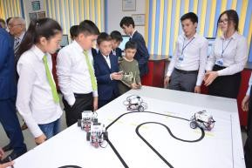
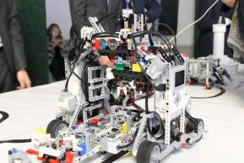
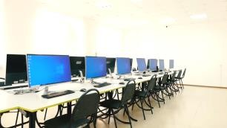
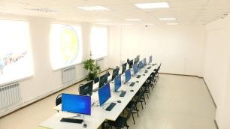

INNOVATION PARK LABORATORIES
Laboratory "Flow data analysts and machine learning"
Laboratory "Robotic Systems“
Laboratory "IT room"
Robotics Laboratory is a professional community of programmers, engineers, designers engaged in the development of robots and robotics systems, artificial intelligence.
Laboratory directions:
Laboratory directions:
research work of students and faculty
consulting on research projects
periodic solutions of differential equations with piece-constant arguments
numerical methods for solving nonlinear boundary value problems for integrated- differential equations Fredholm.
wavelet analysis and its application in the theory of filtration.
exploring the existence of heterogeneous solutions of the Clausen type.
multi-periodic solutions of the system of
equations with differentiating operators.
study, acquisition of experience and skills in the field of programming technology and modeling of computing and information systems.
scientific-research work of students and faculty
conducting consultations on research projects
conducting practical and laboratory classes on information and communication technologies, as well as other disciplines
conducting courses, master classes, workshops
Students learn:
to design and assemble robots;
soldering and working with electronic components;
to apply in practice "boring" knowledge from the course of physics;
to program the robot to adopt solutions and act independently
to take part in competitions and Olympiads in
robotics at a different level;

Slide 24
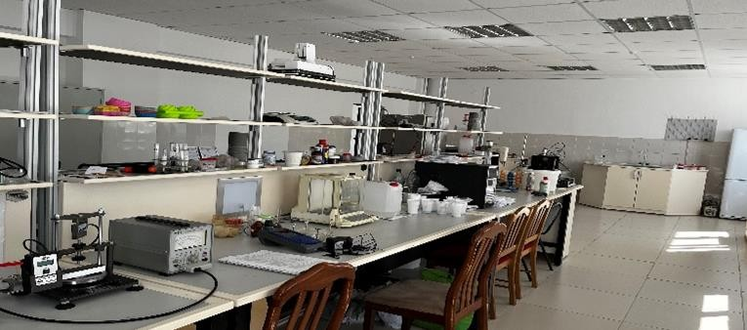
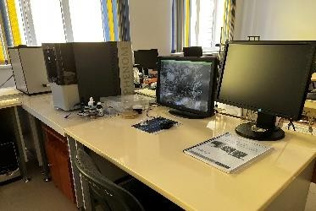
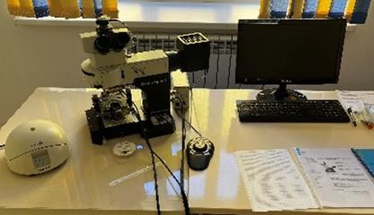
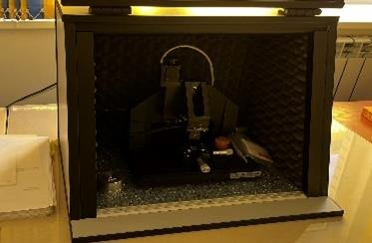
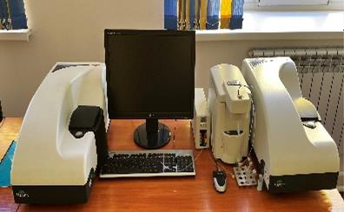
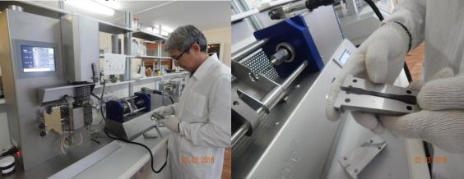
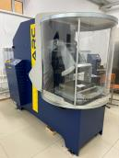
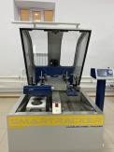
INNOVATION PARK LABORATORIES
Laboratory of "Polymer Composite Materials“ Laboratory of Polymer Composite Materials works on creating polymer composite materials based on polyolefins and various finely dispersed fillers. Research is being carried out on the following topics: Improving the physicochemical and mechanical properties of epoxy composites when microsized mineral fillers are introduced into the polymer matrix. Development of technological bases for functional polymer matrix composites using raw materials of the Aktobe region | Laboratory of Microscopy and Analysis of Nanomaterials The laboratory of microscopy has equipment designed to obtain an image of the object surface with a magnification of 40,000x to visualize the surface of various objects and study their local properties, to measure the geometric parameters of surface topography with nanometer spatial resolution, to measure hardness, to measure the modulus of elasticity, to measure geometric characteristics restored indentations at given points of the surface after indentation with a measured force, followed by the calculation of microhardness, profile analysis and measurement of surface roughness parameters. | Laboratory for "Testing building materials and asphalt concrete“ Purpose: to study the composition of the asphalt concrete mixture and their fillers, gain experience and skills in the construction of road surfaces. This laboratory is designed to conduct practical and laboratory classes in the direction of "Road construction" Benefits of the laboratory: Opportunity to work on advanced foreign equipment of European production. The ability to examine the composition of building materials to determine whether their quality meets the requirements of GOST. Opportunity to exchange experience with foreign partner manufacturers Acquisition of skills that will allow you to become a professional road construction engineer. Laboratory include: Advanced foreign equipment of the Italian company "Matest" Consumables for creating various types of asphalt samples Personal computer for graphic data processing

Slide 25
CONTACT INFORMATION
International Cooperation Department
Zhubanov Aktobe Regional University,
Address: A. Moldagulova 34 A
030000 Aktobe, Kazakhstan
E-mail: international@zhubanov.edu.kz
Director of International Cooperation Department –Dr. Altynay Mustafina

