Slide 1









OSHA Hazard Communication Program Pictograms
Explosive, Organic Peroxide
Flammable, Pyrophoric, Self-Heating
Oxidizer
Gas under Pressure
Corrosive
Acute Toxicity
Irritant, Dermal Sensitizer
Carcinogen, Respiratory Sensitizer, Reproductive Toxin
Environmental Hazard, Acute Aquatic Toxicity
Notes:
This is also known as the Globally Harmonized System.
It is not yet law in the US, but OSHA is moving to adopt this system.

Slide 2




















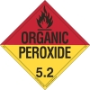




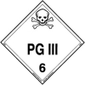

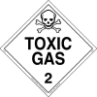
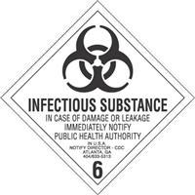
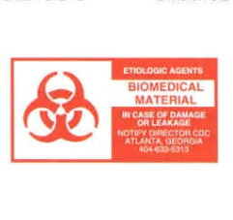




US DOT Hazmat Placards

