Slide 1

Marshall University Department of Public Health
MU MPH Program
MU Minority Health Institute

Slide 2

MPH Hooding Ceremony
April 24, 2023
https://youtube.com/clip/Ugkx3FyM74c3tBuyv5scVE3yIaJ27ODXwIMn

Slide 3
Department of Public Health
MPH Program
2019/2023

Slide 4
MPH Graduation History
2019-2023

Slide 5
Enrollment & Graduates 2021/2022
MPH Program

Slide 6
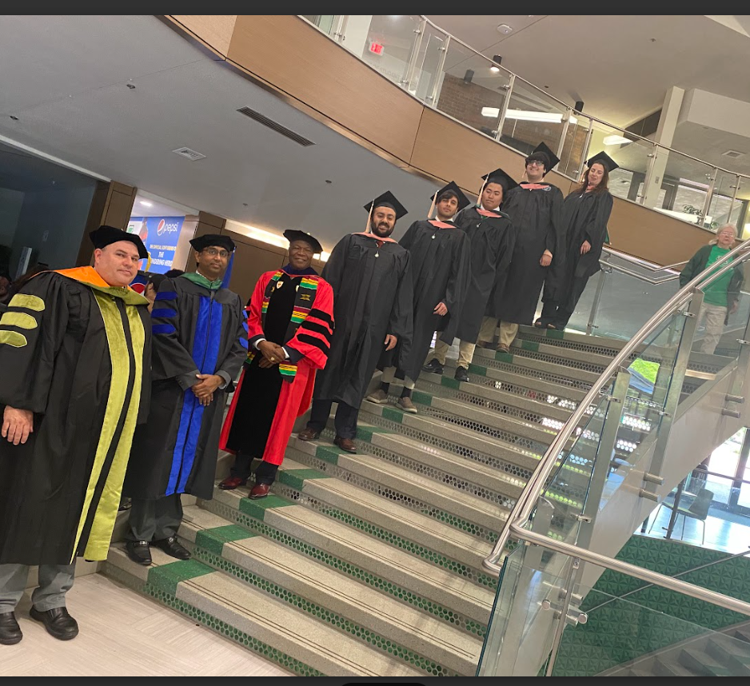
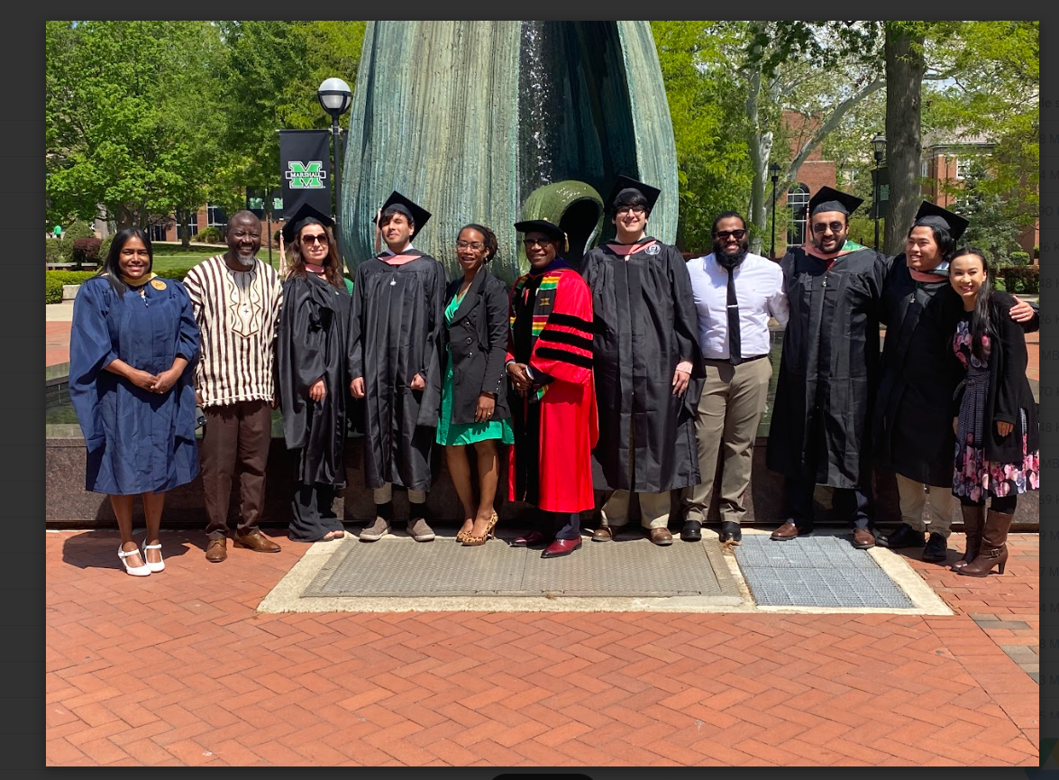
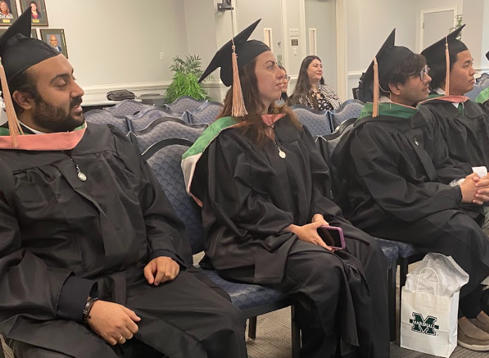
MPH Hooding Ceremony April 24, 2023
MU MPH Hooding Ceremony
April 24, 2023

Slide 7
MU Minority Health Institute
Goal
The goal is to serve as a resource and collaborative partner to community organizations, health care providers, and government agencies in efforts to decrease mortality in minority populations.
Mission
The mission of the West Virginia Minority Health Institute/Office of Minority Health (OMH) is to improve and protect the health and well-being of racial and ethnic minorities through the development of programs, policies, and practices to eliminate health disparities.
Staff
Dr. Anthony T. Woart, Principal Investigator
Dr. Michael Prewitt-Co-Principal Investigator
LaDawna Walker Dean, ABD, MSW, BSW, West Virginia Minority Health Initiative Program Coordinator
Vanessa Alagah, BS, MPH, Health Education Specialist
Jonathan Lung, BS, MPH Candidate, Health Education Specialist
Kazi Sayed, BS, MPH Candidate, Outreach Worker
Research Associates
Dr. Georgiana Logan
Dr. Clinton Brown
Dr. Jerica Wesley
Dr. Nandini Manne
Dr. Boniface Noyongoyo

Slide 8
Project Funded 2021/2024
Year | Project | Funding | Funding Source | Status
02/01/2023-12/31/2023 | Addressing COVID-19 Health Disparities Among Racial and Ethnic Minorities in WV | $71,235.00 | CDC/WV DHHR Bureau for Public Health | Awarded
02/01/2023-06/30/2024 | 2021 COVID-19 Vaccination Equity and Prioritizing Populations Disproportionately Affected by COVID-19 | $199,935. 00 | CDC/WV DHHR Bureau for Public Health | Awarded
10/-01/2022-09/30/2023 | Preventative Block Grant | $100,000.00 | WV DHHR, Bureau for Public Health | Awarded
07/01/2023-06/30/2024 | Unicare/MU Minority Health Institute Community Investment | $456, 000.00 | Unicare | Awarded
07/01/2023-06/30/2024 | WV HEAT Capacity Building Grant | $40,000.00 | WV DHHR Bureau for Public Health/State Rural Health | Awarded
07/01/2023-06/30/2024 | Breast/Cervical Cancer Screening Program | $160,000.00 | WV DHHR Division of Women's and Family Health Office of Maternal, Child and Family Health | Awarded
10/-01/2023-09/30/2029 | WISEWOMAN | $29,000.00 | WV DHHR Division of Women’s and Family Health | Awarded

Slide 9
Project Funded 2021/2024
Year | Project | Funding | Funding Source | Status
07/01/2023-06/30/2024 | WV Minority Health Initiative | $81,000.00 | WV DHHR, Bureau for Public Health | Pending
10/01/2023-08/31/2025 | Substance Abuse Prevention Program | $1, 107, 273.00 | SAMHSA | Pending
10/01/2023-09/30/2029 | MARSHALL UNIVERSITY MINORITY HEALTH INSTITUTE COMMUNITY-BASED PARTNERSHIP TO ADDRESS HEALTH DISPARITIES AMONG AFRICAN-AMERICANS AND HISPANIC AMERICANS IN WEST VIRGINIA | $6, 500,000.00 | CDC/WV DHHR Bureau for Public Health | Pending

Slide 10

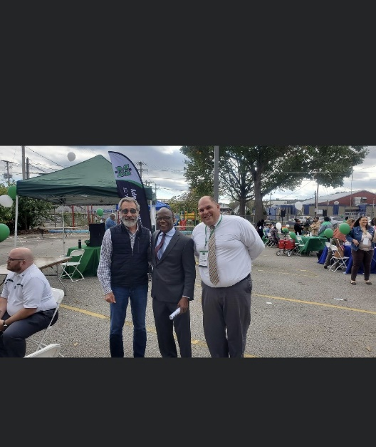
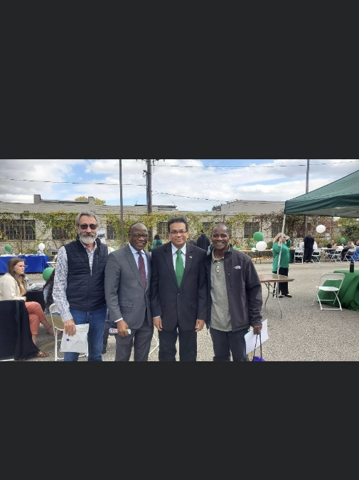
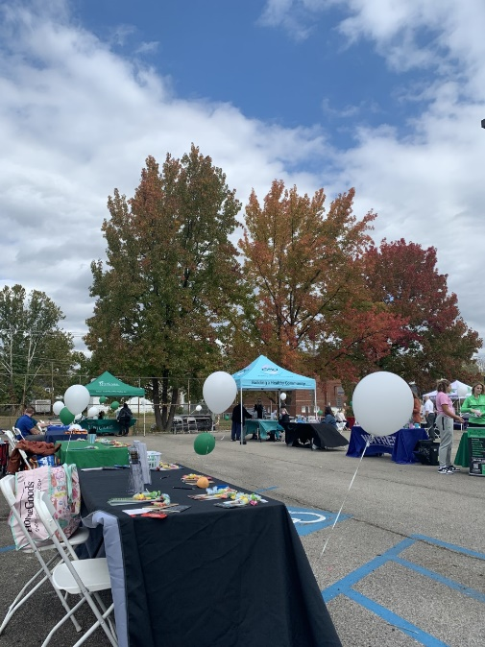
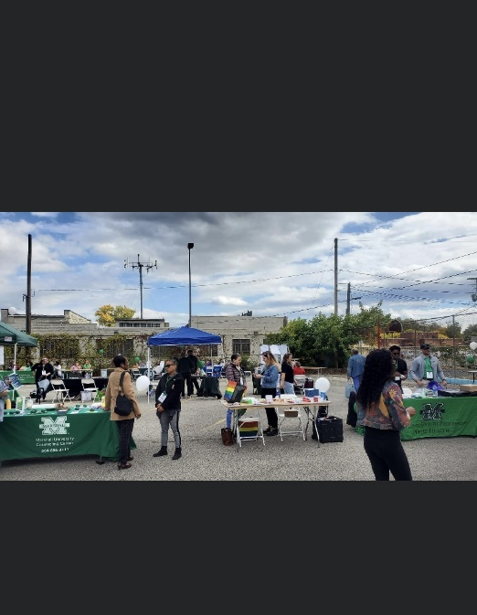
West Virginia Annual Minority Health Fair 2023

Slide 11
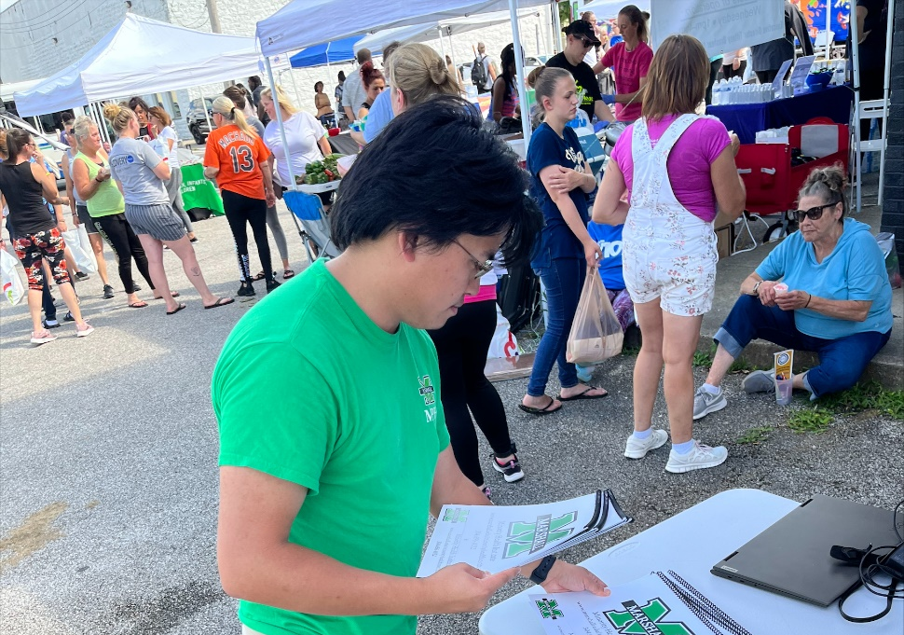
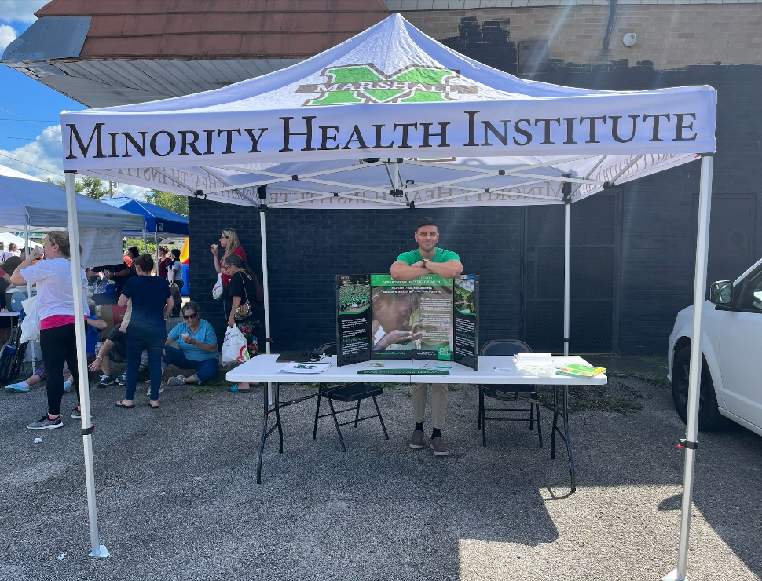
Community Outreach

Slide 12
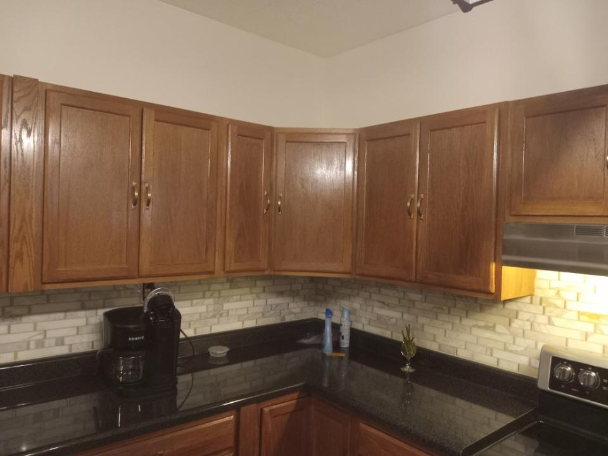
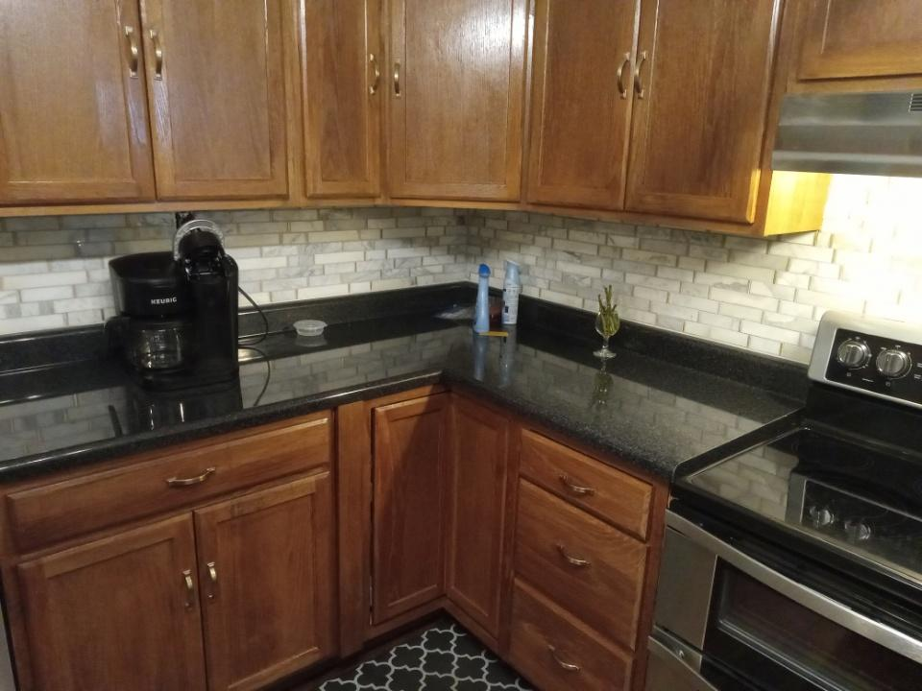
Unicare Community Investment Grant
The Livable Housing Project

Slide 13
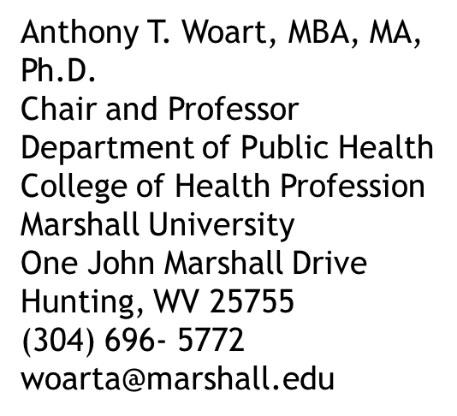
THANK YOU!

