Slide 1


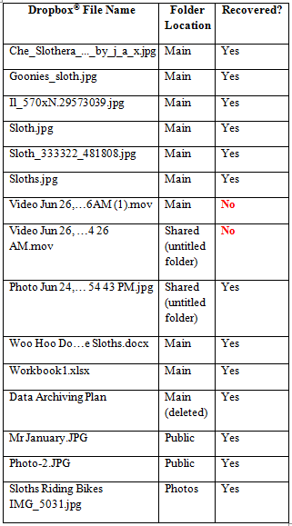
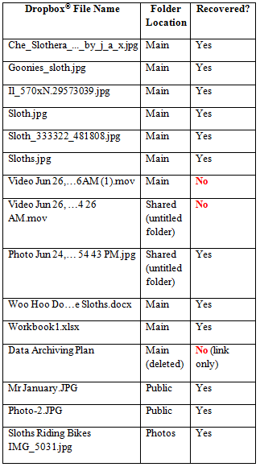
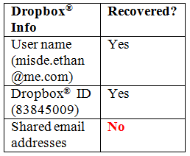

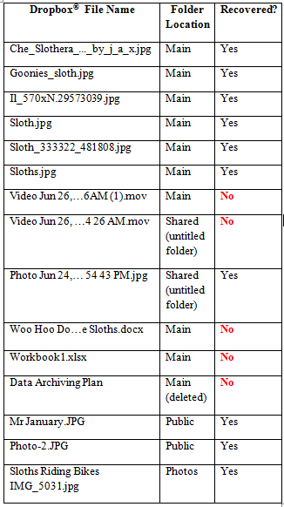

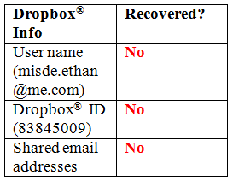
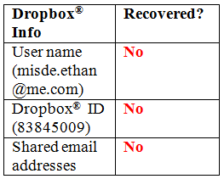
Forensic Analysis of Dropbox® Application File Artifacts
Recovered on iOS and Android Mobile Devices
Sara Treleven, BS^{1*}, Christopher Vance, BS¹, Terry Fenger, PhD¹, Joshua Brunty, MS¹, Jenniffer Price, BA²
¹Marshall University Forensic Science Program, 1401 Forensic Science Dr., Huntington, WV 25701
²Wisconsin Department of Justice, 17 West Main St., Madison WI 53711
Abstract
Results
Discussion and Conclusions
Forensic examination of smartphone mobile devices is hindered not only by the amount of information stored on the device itself, but also the location of the application files used on different operating systems
Dropbox® was installed on a 4th generation Apple iPod Touch running iOS 5.1.1 and an Android smartphone emulator running Android 2.3.3 to examine the file structure layout and data organization of the application files
Physical dumps of both file systems were done and analyses took place using Physical Analyzer version 3.0 and FTK version 4.0.2.33
File structures of both operating systems were similar; however more user data was able to be recovered from the iOS device.
FTK
Physical Analyzer
Dropbox® files stored on the iOS device and on the Android device both showed a similar file structure with all files in their appropriate folders
All JPEG images were recovered from both mobile devices
Microsoft Word and Excel documents were only recovered from the iPod Touch
The deleted Microsoft Word document was recovered on the iPod Touch, but the Android emulator did not show any indication of it being stored on Dropbox®
The .MOV video file associated with Dropbox® was unrecoverable from either the iOS or Android mobile devices
More pertinent information was recovered on the iOS device than from the Android emulator regarding the user
No record of email addresses associated with the “shared” folder were found
Future studies should be conducted to confirm that Dropbox® application files found on the Android emulator are identical to the Dropbox® files found on an actual Android smartphone
iOS
Introduction
Of the world’s almost five billion mobile phones in use, 1.08 billion are smartphones and approximately 100 million of these smartphones are present in the United States alone¹⁰
Illegal pictures and videos can be taken and distributed within seconds and stored in vast amounts on inconspicuous storage devices that are easily concealed
Dropbox® sharing application available for iOS and Android mobile devices has made the information stored using the app more accessible with each device synched to the user’s account
The location of the stored files plays a significant role in forensic analysis as the cloud becomes a larger storage medium than an actual physical hard drive
The ability to recover these files quickly and efficiently from mobile devices running different operating systems can help expedite analysts’ casework
References
1. Android (operating system) [Internet]. 2012. Wikipedia. [cited 2012 June 5]. Available from: http://en.wikipedia.org/wiki/Android_%28operating_system%29
2. Android Developers. 2012. [Internet]. Android. [cited 2012 June 3]. Available from: http://developer.android.com/index.html
3. Bem, D. 2007. Computer forensic analysis in a virtual environment. International Journal of Digital Evidence 6(2).
4. Beta News. [Internet]. Now Anyone, Not Just Cops With a Warrant Can Peek Inside Your Dropbox®. 2012. [cited 2012 July 24]. Available from: http://betanews.com/2011/06/16/now-anyone-not-just-cops-with-a-warrant-can-peek-inside-your-Dropbox /
5. Digital Buzz. [Internet]. Infographic: Mobile Statistics, Stats & Facts 2011. 2011. [cited 2012 July 25]. Available from: http://www.digitalbuzzblog.com/2011-mobile-statistics-stats-facts-marketing-infographic/
6. Dropbox ® (Service). [Internet]. 2012. Wikipedia. [cited 2012 June 5]. Available from: http://en.wikipedia.org/wiki/Dropbox _%28service%29
7. Garfinkel, SL. 2010. Digital forensics research: The next 10 years. Journal of Digital Investigation 7:64-73.
8. Hoog A. 2011. Android forensics: Investigation, analysis, and mobile security for Google Android. 1st Ed. Massachusetts. Syngress. p. 102-20.
9. OS X [Internet]. 2012. Wikipedia; [cited 2012 June 5]. Available from: http://en.wikipedia.org/wiki/OS_X
10. Pew Internet. [Internet]. Nearly Half of American Adults are Smartphone Owners. 2012. [cited 2012 July 23]. Available from: http://pewinternet.org/Reports/2012/Smartphone-Update-2012.aspx
11. Phonedog. [Internet]. Number of U.S. Smartphone Subscribers Surpass 100 million, Says ComScore. 2012. [cited 2012 June 25]. Available from: http://www.phonedog.com/2012/03/08/number-of-u-s-smartphone-subscribers-surpasses-100-million-says-comscore/
12. PC Mag. [Internet]. Smartphone App Downloads Jump 28 Percent 2011. [cited 2012 June 26]. Available from: http://www.pcmag.com/article2/0,2817,2404502,00.asp
13. Vidas, T., Zhang, C., and C. Nicolas. 2011. Toward a general collection methodology for Android devices. Journal of Digital Investigation 8:14-24.
Table 1. Recovered Dropbox® files and user information from the iOS iPod Touch after analyses with FTK and Physical Analyzer software.
FTK
Physical Analyzer
Materials and Methods
Research Devices
  4th Gen. iPod Touch with iOS 5.1.1 operating system
  Dropbox® version 1.5.2 for iOS
  MacBook Pro with OS X Mountain Lion running an Android emulator with Android 2.3.3 operating system
  Dropbox® version 2.1.2 for Android
Forensic Software
  FTK version 4.0.2.33
  Physical Analyzer version 3.0
Standard Research Folder
  9 JPG image files
  1 Microsoft Word document
  1 Microsoft Excel document
  1 video (taken and uploaded with iPod Touch)
  1 deleted Microsoft Word document
Dropbox Information
  Username: misde.ethan@me.com
  Dropbox® ID: 83845009
Android
Acknowledgements
The author thanks Christopher Vance, Dr. Terry Fenger, Dr. Pamela Staton, and Josh Brunty from the Marshall University Forensic Science Center for their guidance and instruction, as well as Special Agent in Charge Jenniffer Price, Lead Criminal Analyst Tim Lokrantz, and Criminal Analysts Mark Howard, Chris Kendrex, Florian Berger, Toby Carlson, and Christine Byars at the Department of Justice’s Division of Criminal Investigation Computer Forensics Unit in Wisconsin.
Table 2. Recovered Dropbox® files and user information from the Android emulator after analyses with FTK and Physical Analyzer software.
Notes:
Is it possible to take out some references?

