Slide 1

Jared Bradley
Heather Tolnay

Slide 2
What is EIM® ​
Was cosponsored by the American Medical Association(AMA) and American College of Sports Medicine(ACSM) in 2007​
Has spread to over 40 countries​
Has the vision of spreading research and clinical based evidence resources to everyone.

Slide 3
The Longterm Vision of EIM® ​
Have health care providers assess patient's level of PA
Determine if the patient is meeting the Physical Activity Guidelines for Americans​
Provide patients with counseling to reach the guidelines
Refer the patient to either health care or community-based resources for further guidance

Slide 4
The Current Goals of EIM® ​
Embed the physical activity vital sign (PAVS) into electronic medical records (EMRs)​
Develop a national network of evidence-based PA programs and resources​
Provide a clinical decision support system linking clinical and community, so that HCPs can offer behavioral PA counseling and refer patients to fulfill their PA “prescription” in the community

Slide 5
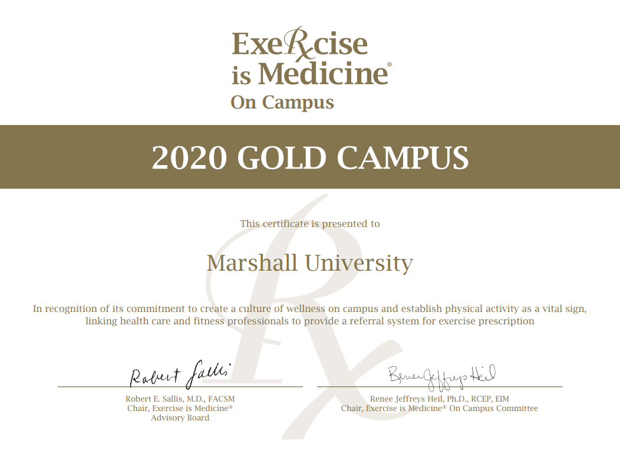

Slide 6
EIM® On Campus​
Making movement a part of the daily campus culture​
Assessing physical activity at every student health visit​
Providing students with the tools necessary to strengthen healthy PA habits that can last a lifetime​
Connecting university health care providers and fitness specialists to provide a referral system.

Slide 7
Importance
The current literature
  Declining Physical Activity Levels
  More Sedentary Behaviors
  Prevalence of Metabolic Conditions

Slide 8
EIM® at Marshall Fall 2019​
Campus wide walking measurements
Distance

Slide 9
Goals of On Campus Walking Measurements​
Increase awareness of PA​
Increase levels of PA​
Provide distances to track PA​
Increase the accessibility of campus for PA

Slide 10
Methods​
Survey wheel​
Mean participants steps​

Slide 11
Participants​
Marshall University Exercise Science​
Marshall University Students​
Marshall University Staff​
Community Engagement

Slide 12
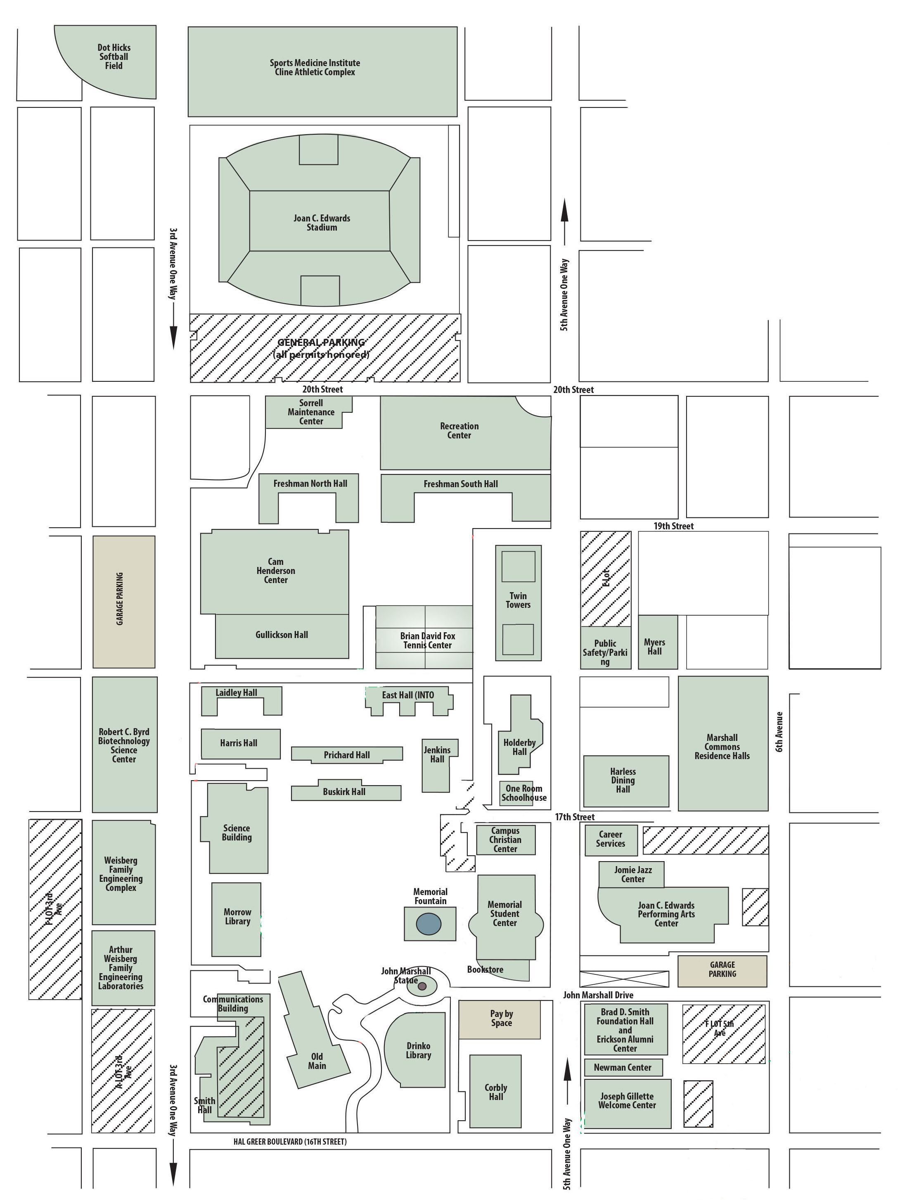
Results
Distance: 1414 Feet
  Miles: 0.27
  Steps: 650
Distance: 2563 Feet
  Miles: 0.49
  Steps: 1095
Distance: 6826 Feet
  Miles: 1.29
  Steps: 2923
Distance: 1880 Feet
  Miles: 0.36
  Steps: 777

Slide 13
Results
Distance: 778 Feet
  Miles: 0.15
  Steps: 392
Distance: 734 Feet
  Miles: 0.14
  Steps: 378
Distance: 1043 Feet
  Miles: 0.20
  Steps: 527
Distance: 1215 Feet
  Miles: 0.23
  Steps: 549

Slide 14
Results
Distance: 1677 Feet
  Miles: 0.32
  Steps: 611
Distance: 1775 Feet
  Miles: 0.34
  Steps: 692
Distance: 1465 Feet
  Miles: 0.28
  Steps: 606

Slide 15
Walk at Work​
Gullickson Hall 1st Floor Hallway (Horseshoe)
  Distance: 423 Feet
  Miles: 0.08
  Steps: 211

Slide 16
Walk at Work​
Science Building Hallway (Loop)
  Distance: 535 Feet
  Miles: 0.10
  Steps: 265

Slide 17
Walk at Work​
Old Main Hallway
  Distance: 383 Feet
  Miles: 0.07
  Steps:192

Slide 18
Walk at Work​
Henderson Center 1st Floor Hallway (L-shaped)
  Distance: 571 Feet
  Miles: 0.11
  Steps: 271

Slide 19
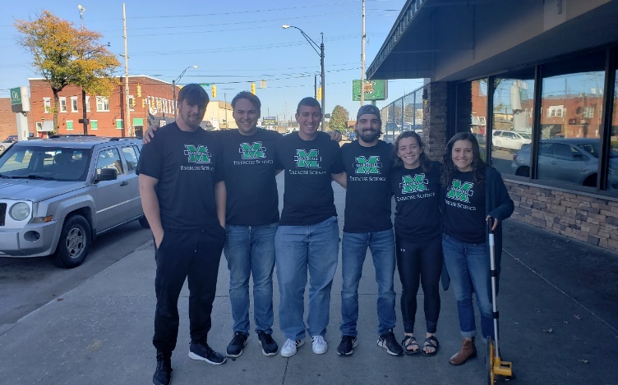
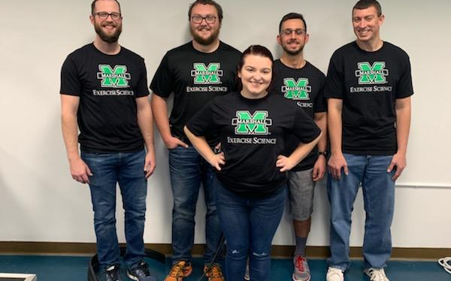
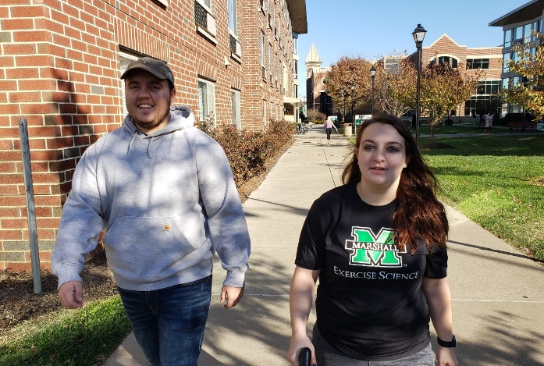
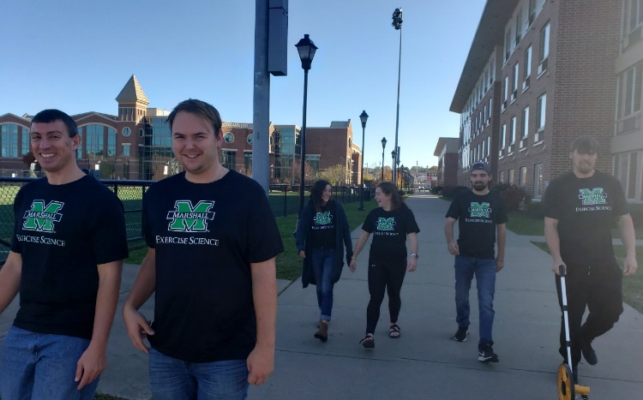
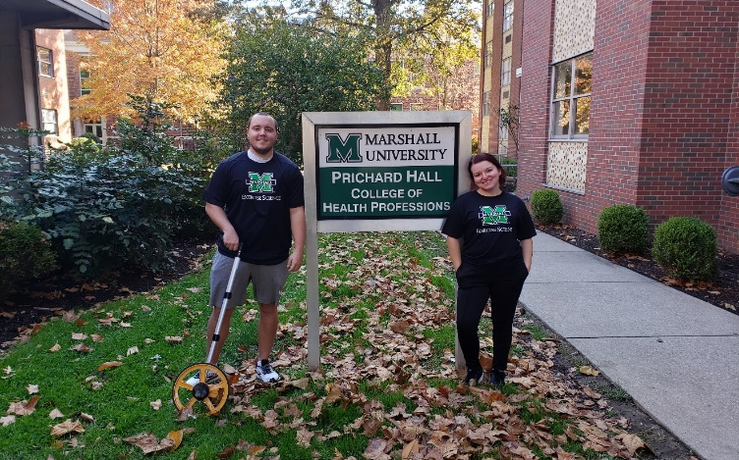
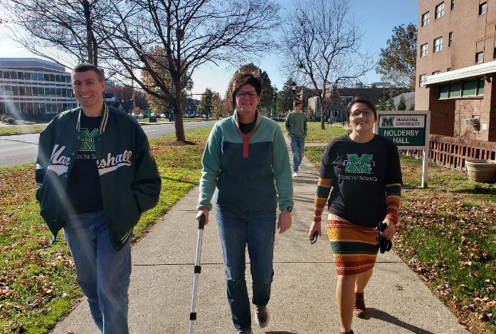

Slide 20
Future Implications
Path markers
Building plans including distances
Walk at work events
Student involvement to increase physical activity levels

Slide 21
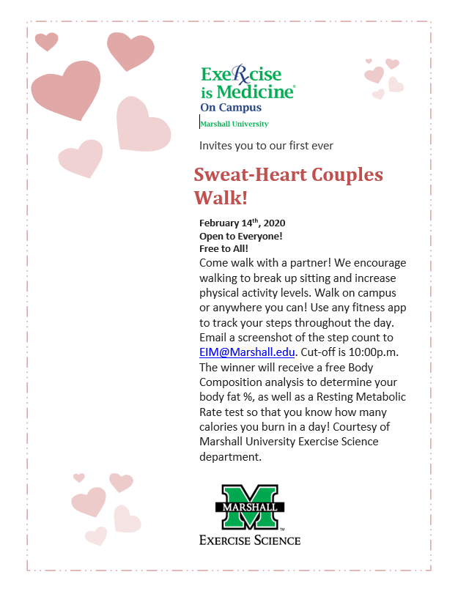
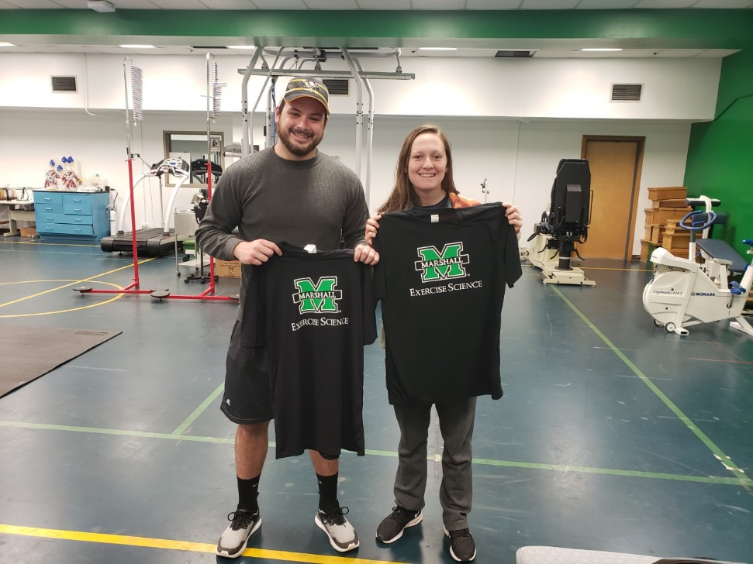
Other Projects
Winning Step Count:
31,198 Steps!
That is nearly 15 Miles!

Slide 22
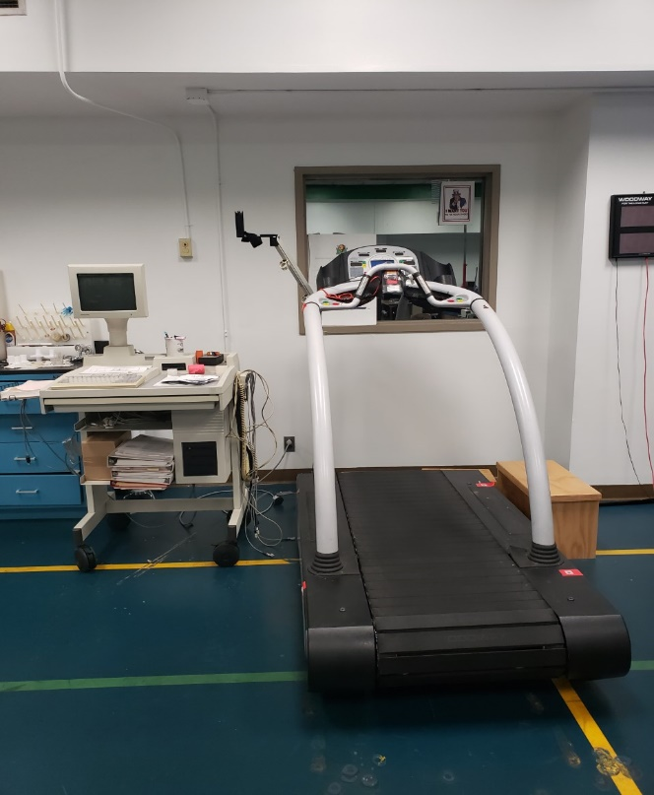
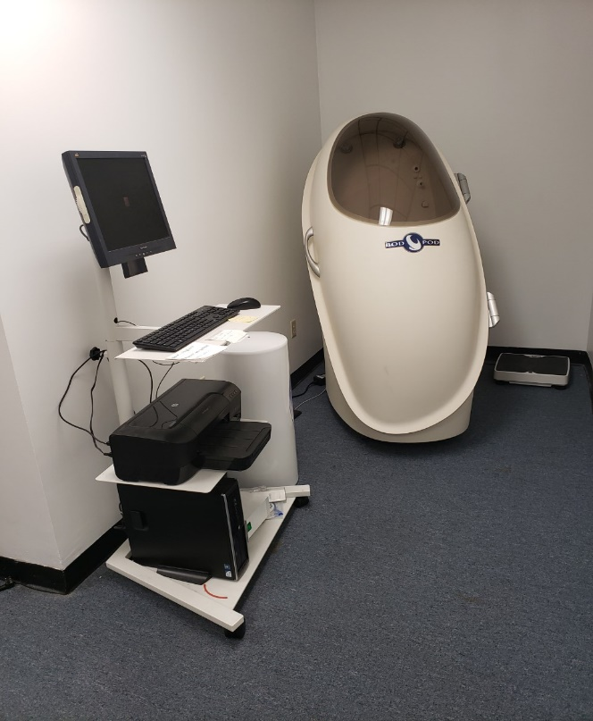
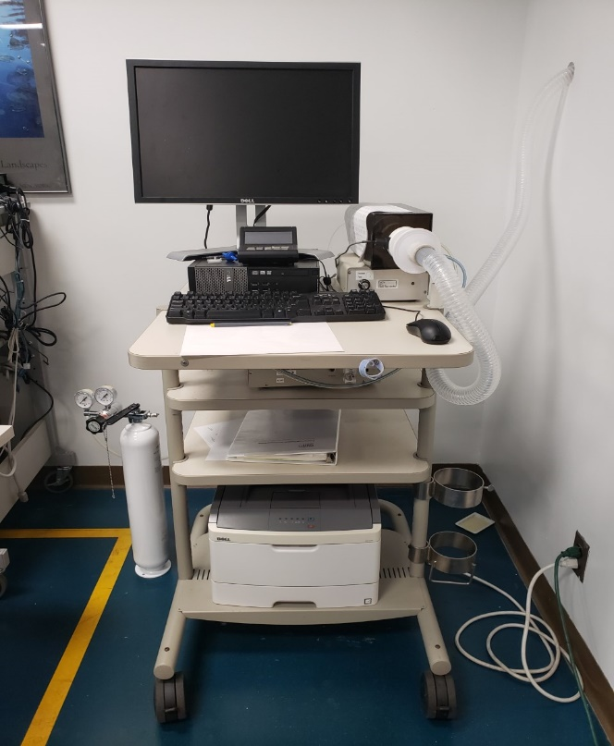
Marshall University Exercise Physiology Lab

Slide 23
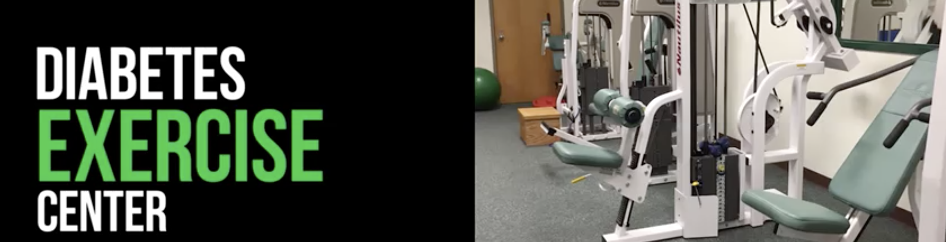
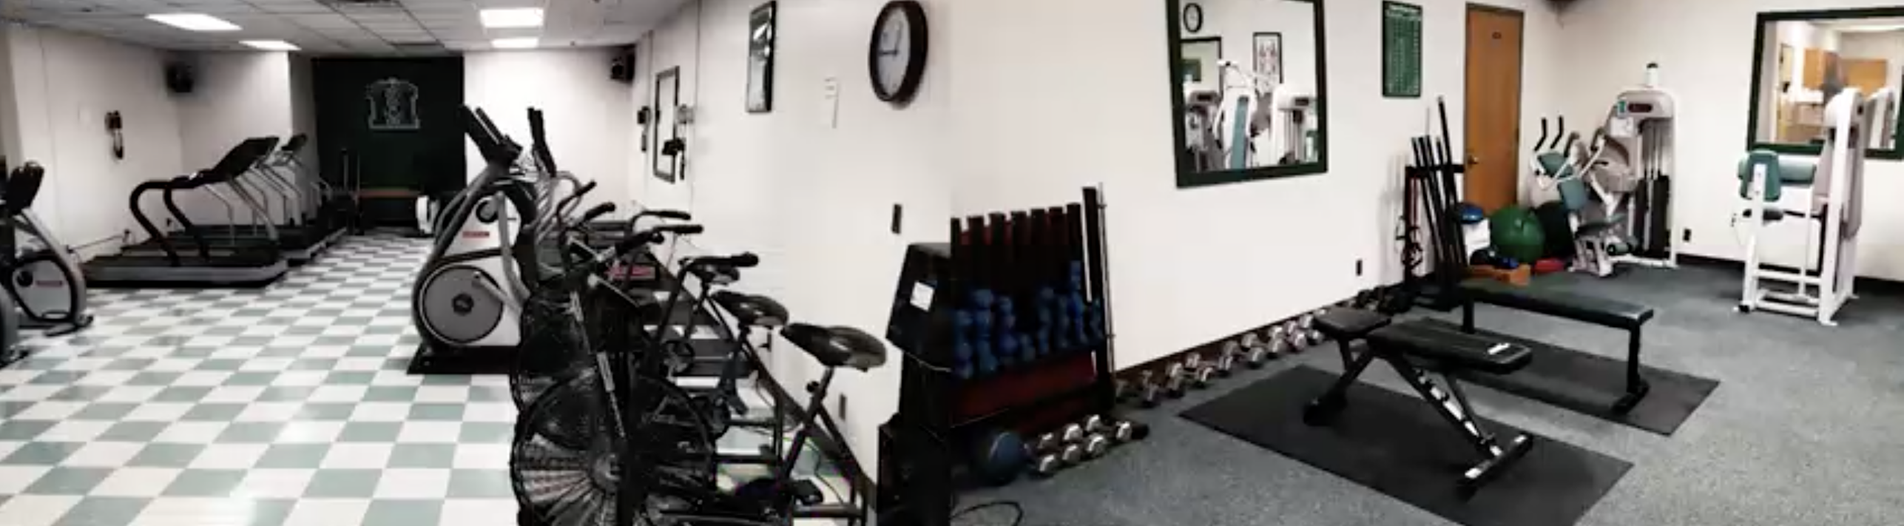

Slide 24
Future Projects
Off campus walking measurements
Health Apps
Step Counts

Slide 25
References​
De Cocker, et. All. (2010). Associations between sitting time and weight in young adult Australian women. Preventive Medicine, 51(5), 361-367.
Ojo, S. O., et. All. (2019). Breaking barriers: using the behavior change wheel to develop a tailored intervention to overcome workplace inhibitors to breaking up sitting time. BMC public health, 19(1), 1126-1126.
Dunstan, et. All. (2012). Breaking up prolonged sitting reduces postprandial glucose and insulin responses. Diabetes Care, 35(5), 976-983.
Healy, et. All. (2008). Breaks in sedentary time: beneficial associations with metabolic risk. Diabetes Care, 31(4), 661-666.
Altenburg, et. All. (2013). The effect of interrupting prolonged sitting time with short, hourly, moderate-intensity cycling bouts on cardiometabolic risk factors in healthy, young adults. Journal of Applied Physiology, 115(12), 1751-1756.
Exerciseismedicine.org
Lee, et. All. Physical Activity Series Working, G. (2012). Effect of physical inactivity on major non-communicable diseases worldwide: an analysis of burden of disease and life expectancy. Lancet, The, 380(9838), 219-229. Benatti, et. All. (2015). The Effects of Breaking up Prolonged Sitting Time: A Review of Experimental Studies. Medicine & Science in Sports & Exercise, 47(10), 2053-2061.
Ozemek, et. All. (2019). Global physical activity levels - Need for intervention. Progress in Cardiovascular Diseases, 62(2), 102-107. Healy, et. All. (2013). Reducing sitting time in office workers: Short-term efficacy of a multicomponent intervention. Preventive Medicine, 57(1), 43-48.
Smith, et. All. (2015). Weekday and weekend patterns of objectively measured sitting, standing, and stepping in a sample of office-based workers: the active buildings study. BMC public health, 15(1), 9-9.

Slide 26
Acknowledgements​
We would like to thank the University, the faculty of the Exercise Science Department and all of our students that helped make these projects possible.
We would also like to thank the REC Center, Student Health Services, and the other collaborative entities that made the EIM® on campus Gold Status possible.

