Slide 1
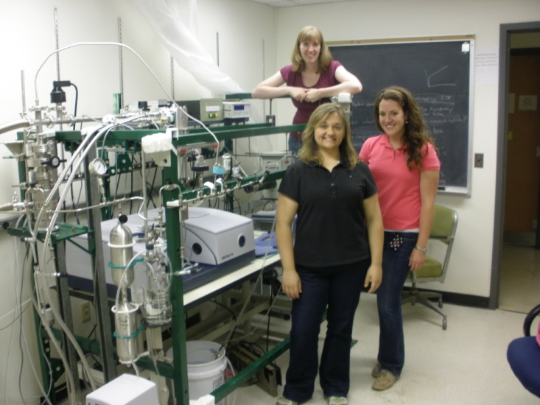
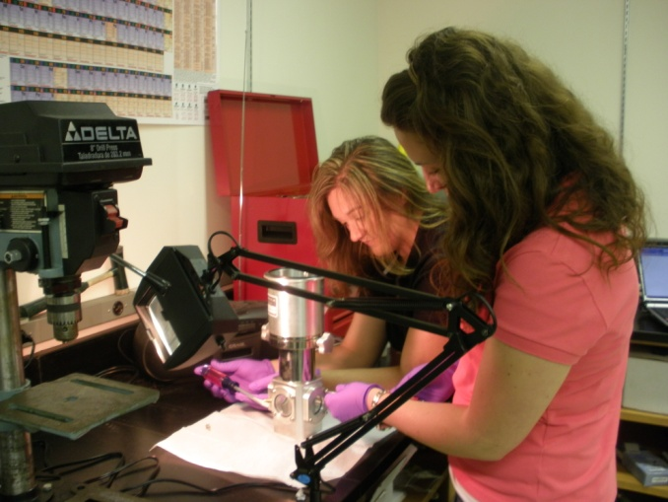
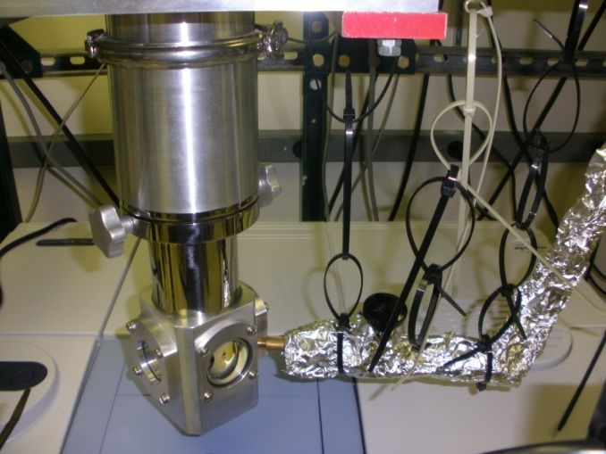
The McCunn Lab
We use a technique called matrix isolation to trap molecules in a frozen matrix of argon atoms.
FTIR spectroscopy measures the vibrational spectrum of the trapped molecules, which allows us to deduce their structure.
How matrix-isolation FTIR works
Trapping molecules in a cold matrix allows us to study reactive species, such as radicals, that cannot be studied with a conventional FTIR instrument.
Our matrix-isolation FTIR instrument was designed and built by Marshall students in collaboration with Dr. McCunn.
CsI Window (10 K)
Infrared light
Transmitted IR light is sent to the FTIR spectrometer for analysis.
= argon atom
= sample molecule
Argon and azobenzene are being sprayed onto the CsI window inside the cryostat shown here.
Summer 2010 research team
Allison Combs, Sara Lilly (front) Dr. Laura McCunn (back)
Allison and Sara assemble the instrument during their summer research fellowships.

Slide 2
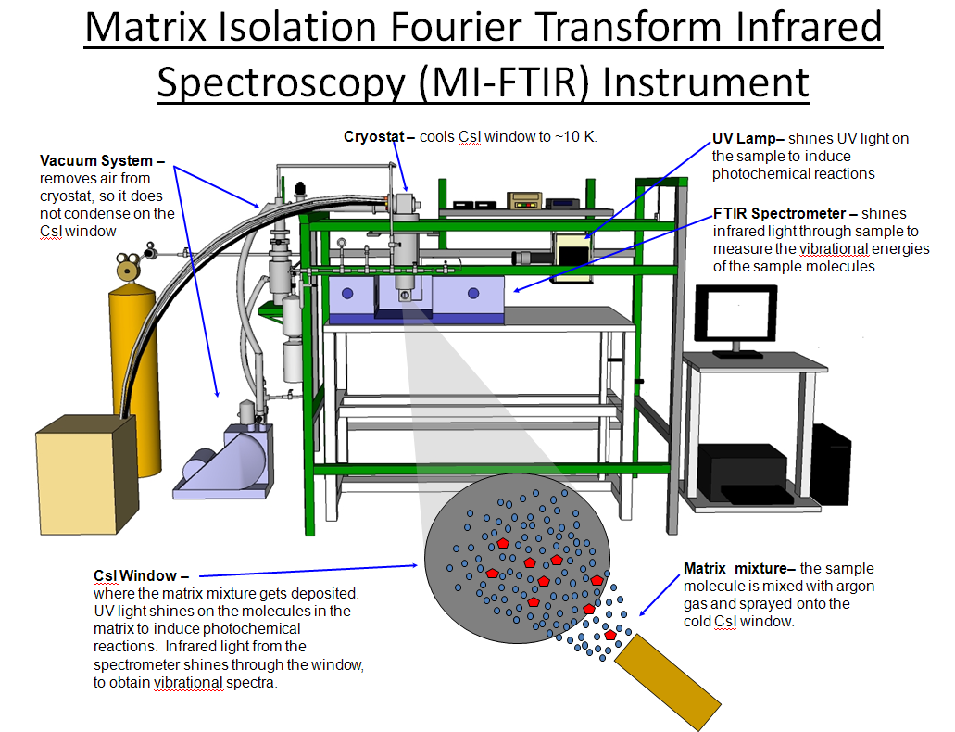

Slide 3
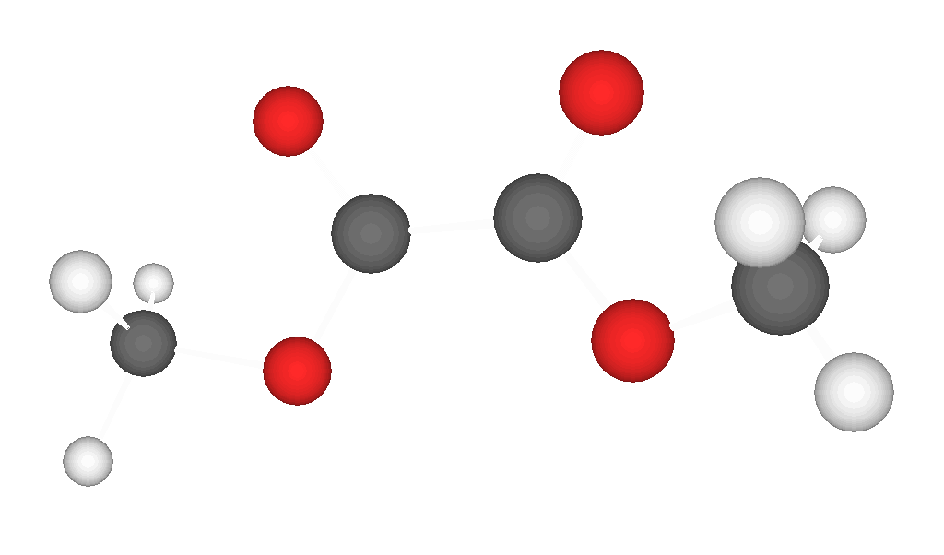
Research in Progress: Dimethyl Oxalate
Dimethyl oxalate is a possible precursor to the methoxycarbonyl radical, which is a known participant in combustion processes.
Dimethyl Oxalate
We want to trap dimethyl oxalate on the cold window inside the MI-FTIR instrument and use ultraviolet photolysis to make the methoxycarbonyl radical.
Methoxycarbonyl radical
This preliminary spectrum results from dimethyl oxalate trapped in argon. Water is also present in the matrix.
We are currently working to improve the spectrum by eliminating the water. Then, we will irradiate the matrix with a UV lamp. If the FTIR spectrum changes after irradiation, then a photochemical reaction has occurred.

