Slide 1
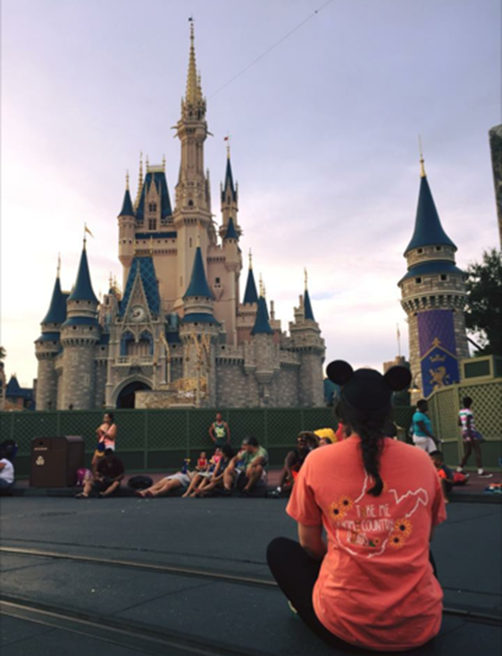
Disney College program

Slide 2

Application process
Fall 2019 Applications are OPEN!
  2019 Fall: Approx. Mid/late August to early January
  2019 Fall Advantage: Approx. Mid-May to early January
Must be enrolled in school or recent graduate
Apply online with general information and recent employment.
Pick top 5 roles you would prefer
Pick when and where

Slide 3
Application process
    Resume:
    Application based
    Use Disney friendly words
      Guest vs. Customer
      Attraction vs. Ride
      4 Keys of Disney: Safety, Courtesy, Show, and Efficiency (work these in)
Role Ranking:
Tip: Put a check next to everything if you’re willing to work there – better chance!
Get familiar with each role
Screen shot your preferences so you can remember them at a later date (phone interview)

Slide 4
Application process
Web Based Interview
  Personality test (20-30 minutes)
  Test of skills (20-30 minutes)
  Be consistent
  Repetitive questions:
    I am always on time
    I am almost never late
  Strongly Agree to Strongly Disagree Section
  The Most Like Me to The Least Like Me Section
I work really well as a team
I work best independently

Slide 5
Application process
Web Based Interview (cont.)
  “So, say you get the WBI question of "I am almost never late", would you want to say something like "most like me"/"strongly agree" or something more like "never like me"/"strongly disagree"? The "almost" in the question confuses me! Thanks so much﻿”
  The wording is often confusing. Take your tome really figuring out what the question is asking! To that answer, I would say strongly agree. A little tip is when they have words like “almost” or “hardly” or thing like that...remove it from the sentence. So, it becomes “I am never late”. It gives you a better understanding of what the statement is ACTUALLY saying, and then you can put the word back in and see how it affects the statement!﻿
      Use “Strongly agree” or “Strongly Disagree” - Disney wants to see you’re confident in yourself and who you are as a worker. Only 3-4 neutrals.
      Once you’re finished: “Congratulations!” or “Not moving on”

Slide 6

Application process
Schedule phone interview (20-30 minutes)
  They can call 15 minutes before or after scheduled time

Slide 7
Phone interview
Answer saying “Hello, this is _____.”
Have notes prepared
Write down interviewers name and use it when appropriate
Pretend you are actually meeting in person.
  Smile
  Dress up
First, the interviewer will briefly go over what the interview will be like.
Then the interviewer will ask questions about your application
  What were your responsibilities at Job A?
  Why did you leave job B?
  Why do you want to do this program? *
Scenario questions
  What would you do if a child was too short to ride an attraction you were working?
  Are you comfortable with heights?
  Explain a time when you were in a situation ….

Slide 8
The waiting game…
The longer you wait, the better!
After receiving acceptance email…
  Sign online documents and sign up for housing
  Pay fee for housing and acceptance fee ($200- $300)
Housing
  Chatham Square, Patterson Court, Vista Way, The Commons
  One to four bedrooms, double occupancy rooms
  Fully furnished
  Bus transportation system

Slide 9


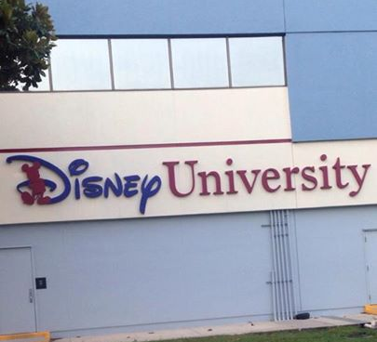
College credit
Talk to advisor
6 hours credit for internship “Special Topics”
You can take 2 Disney Classes while on the program. Each being 3 hours credit. Total of 12 hours for the semester!
Classes
  Corporate Communications, Marketing YOU, Mgt, hospitality, creativity, leadership…
Professional Development
  Engineering, Finance, Entertsinment, Security
Seminars
  Heritage, MKT and Sales, Guest Service…

Slide 10
Earning
Costumes provided
Weekly paycheck
Direct Deposit
Cast Member Discounts
Perks and Benefits
Free Entry for you
Free entry for your friends and family (3 guests 3 times a year)
Discount tickets and hotels
Discount on merchandise and food
40 miles from beach

Slide 11
