Slide 1


Virtual meet and greet with the wv behavior/mental health technical assistance center
CLICK HERE
to get started!
Start Slide Show
This will ensure that all images
and links work properly.

Slide 2


Navigation tips
Every image you will see is clickable
PowerPoint needs to be in Slide Show mode for links to work correctly
Press the back button (bottom left corner of your screen) to return to the topic you were just exploring
Click the home icon (bottom right corner of your screen) any time you would like to go back to the beginning
Click here to start!

Slide 3

Welcome to the TA Center! Click here to learn more about who we are and the work we do across the state.

Slide 4


Who are we?
The West Virginia Behavior/Mental Health Technical Assistance Center was created in 2018 from an outcry for support from educators across the state. The Technical Assistance (TA) Center is a collaboration between the West Virginia Autism Training Center at Marshall University and the West Virginia Department of Education’s Office of Special Education.
Click below to “meet us” and learn more!
MEET OUR
PROGRAM EVALUATOR
Meet the
director
Meet our
projects

Slide 5
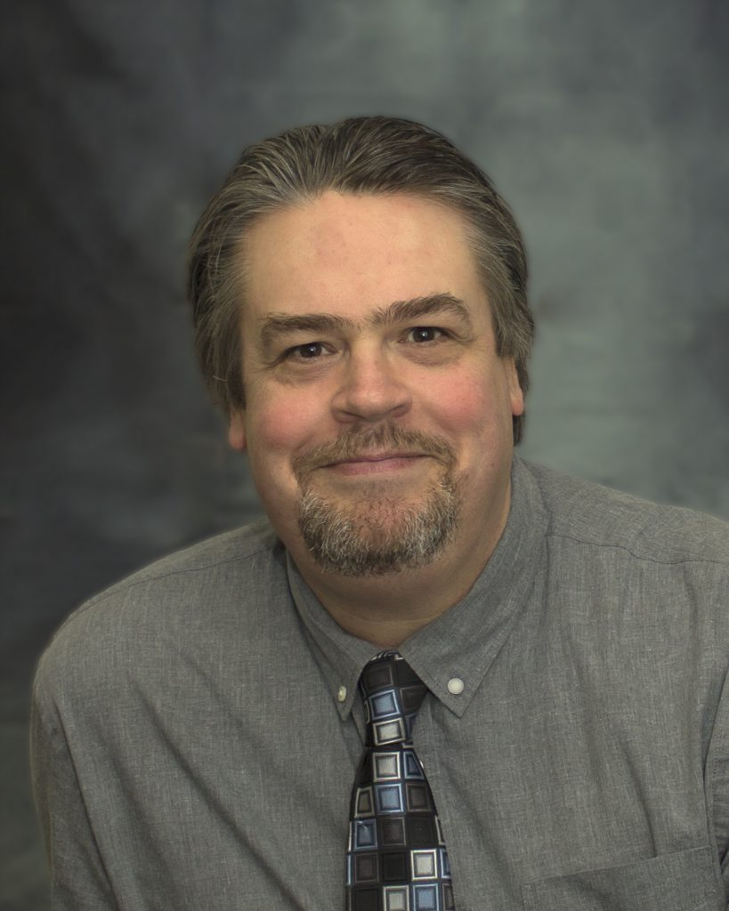
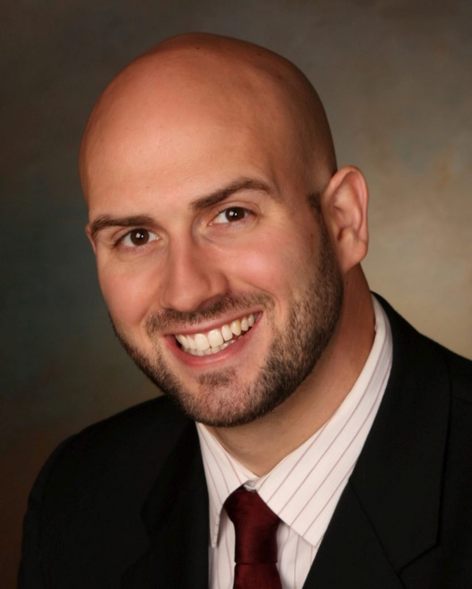



WV Autism training center
Marc Ellison
Executive Director
Autism Training Center
Jim Harris
Associate Director of Training
Autism Training Center
Website
Click on images for more about each director.

Slide 6

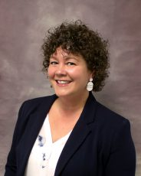
Amy kelly director of technical assistance
WV behavior/mental health ta center
Video Message
Website
E-Mail
Biography

Slide 7

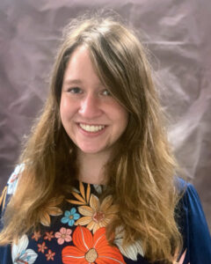
Anna Shreve program evaluator
WV behavior/mental health ta center
E-Mail
See Some of Our Data
Biography

Slide 8
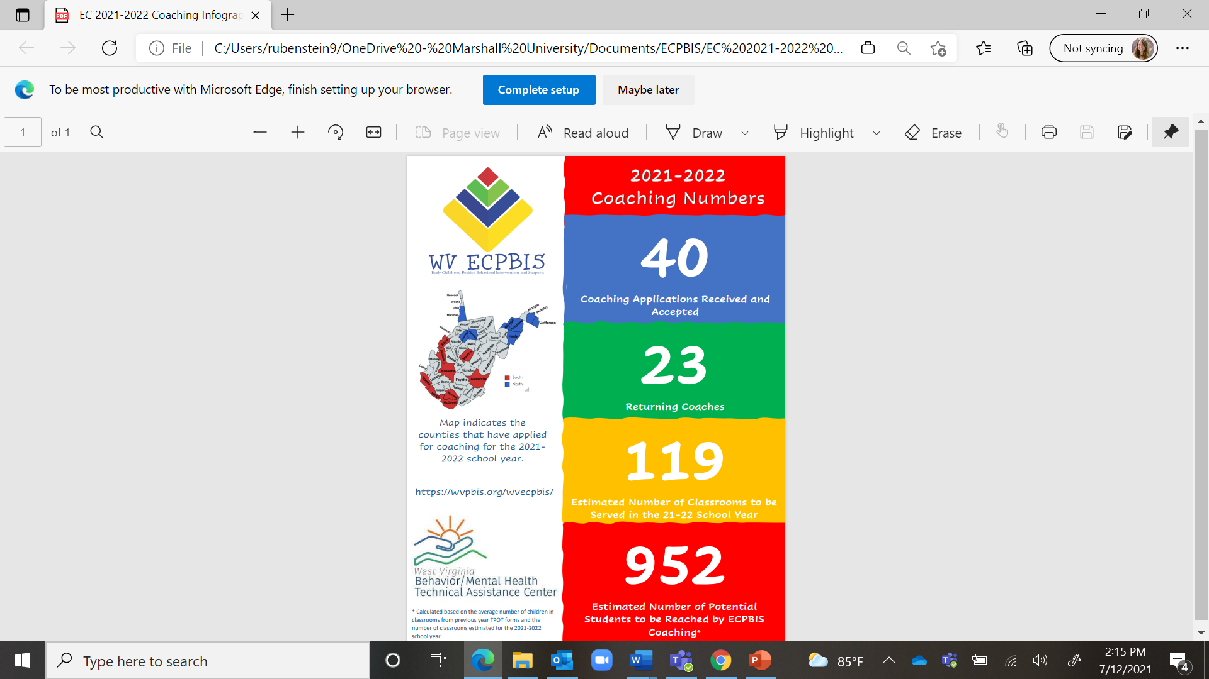
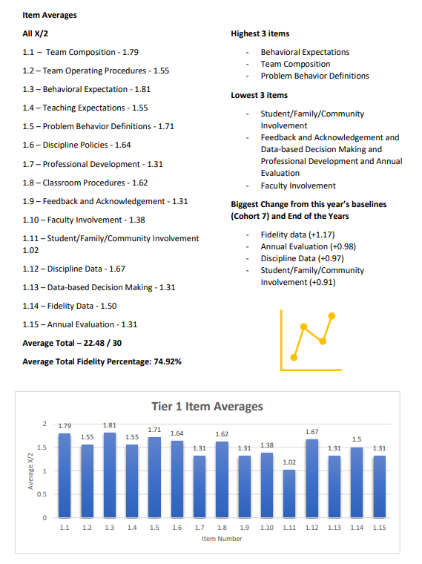
See some of our data
School-Wide Tier 1 Fidelity Data
Early Childhood Coaching

Slide 9



Meet our projects
Click on images for more about each project.

Slide 10



Early childhood pbis
Our
Website
Meet the Coordinator
Meet the
Team
Our Favorite Resources

Slide 11
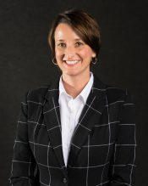
Amy Carlson
Early Childhood pbis coordinator
WV behavior/mental health ta center
Video Message
E-Mail
Biography

Slide 12
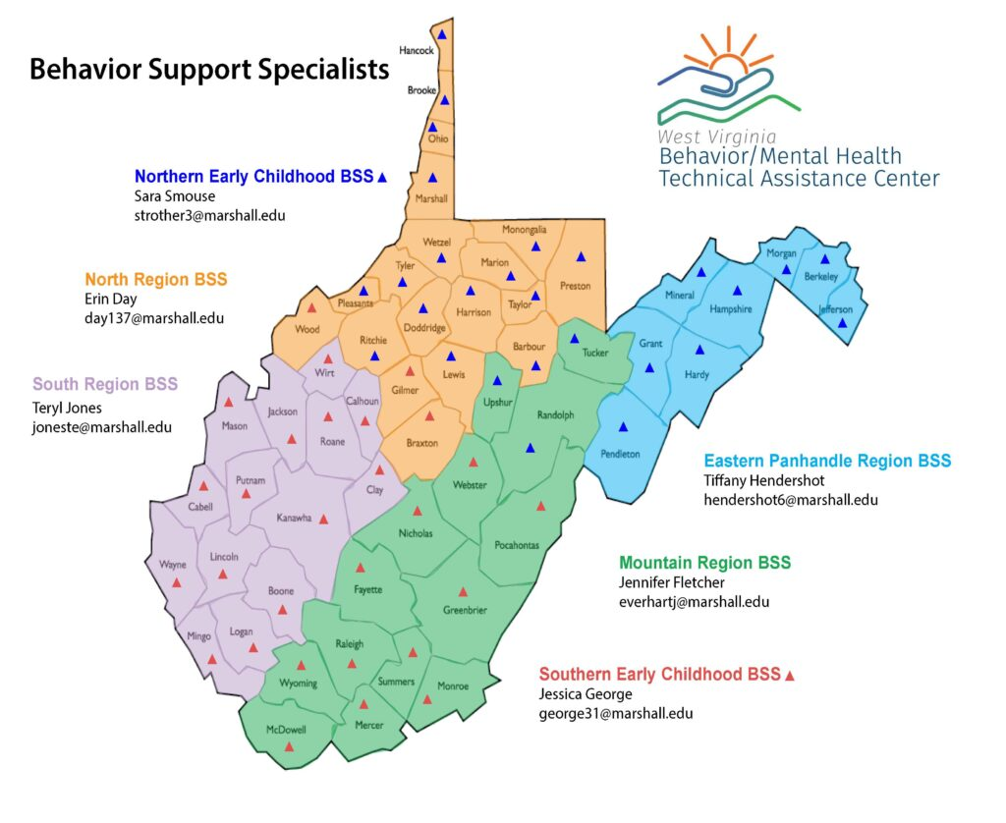
Meet the team
Click on your county to learn more about your Behavior Support Specialist!

Slide 13
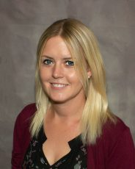
Sara smouse early childhood behavior support specialist
Northern region
Video Message
E-Mail
Biography

Slide 14
early childhood behavior support specialist southern region
The Behavior/Mental Health TA Center is currently in the process of filling this position.
All information will be updated when the new Early Childhood Behavior Support Specialist for the Southern Region has officially joined our team!

Slide 15
Our favorite resources
www.wvecpbis.org
www.challengingbehavior.org
https://eclkc.ohs.acf.hhs.gov/professional-development/article/practice-based-coaching-pbc
https://challengingbehavior.cbcs.usf.edu/Pyramid/pbs/TTYC/tools.html
https://expertfile.com/experts/george.sugai/george-sugai-phd

Slide 16
school-wide pbis
Our
Website
Meet the Coordinator
Meet the
Team
Our Favorite Resources

Slide 17
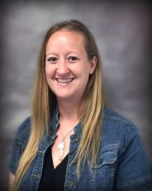
Alicia ziman school-wide pbis coordinator
WV behavior/mental health ta center
Video Message
E-Mail
Biography

Slide 18

Meet the team
Click on your county to learn more about your Behavior Support Specialist!
Project aware schools
Project AWARE is currently serving selected schools in Cabell, Clay, & Harrison Counties.

Slide 19
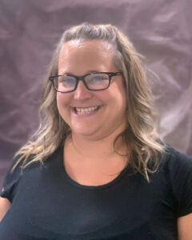
Erin Day behavior support specialist
Northern region
Video Message
E-Mail
Biography

Slide 20
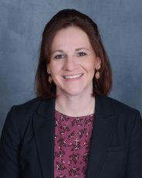
Tiffany Hendershot behavior support specialist
Eastern panhandle
COMING SOON!
*Tiffany is currently on Military leave.*
E-Mail
Biography

Slide 21
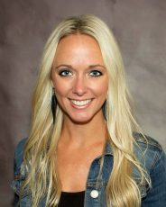
Jen fletcher behavior support specialist
Mountain Region
Video Message
E-Mail
Biography

Slide 22
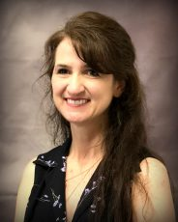
Teryl jones behavior support specialist southern region
Video Message
E-Mail
Biography

Slide 23


Project aware
Project AWARE Schools
Meet the Behavior Support Specialist
Website
coming soon!
Read More about Project AWARE

Slide 24

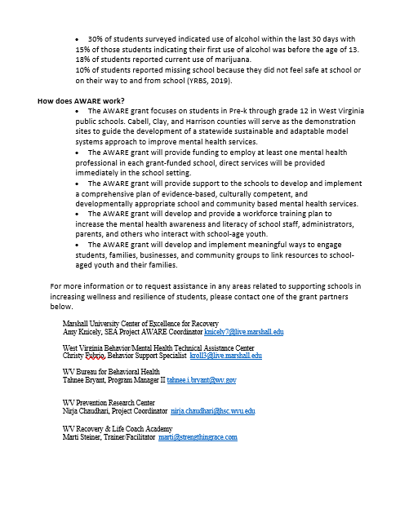

Slide 25
Project aware schools
Milton Elementary School
Milton Middle
School
Cabell Midland High School
Clay County Elementary School
Clay County Middle School
Clay County High School
Adamston & Wilsonburg Elementary Schools
Washington Irving Middle School
Robert C Byrd High School
Cabell County
Clay County
Harrison County

Slide 26
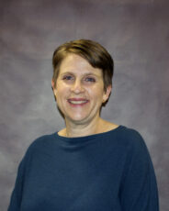
Christy fubio behavior support specialist project aware
Video Message
E-Mail
Biography

Slide 27
Our favorite resources
www.wvpbis.org
www.pbis.org
www.midwestpbis.org
Florida PBIS Project (usf.edu)
www.pbismissouri.org
https://www.pbisworld.com/
https://dhhr.wv.gov/BBH/about/Children,YouthandFamilies/Pages/default.aspx
https://expertfile.com/experts/george.sugai/george-sugai-phd

Slide 28
mental health first aid
Our
Website
Meet the Coordinator
Our Favorite Resources

Slide 29

Dianna bailey-miller mental health first aid coordinator
WV behavior/mental health ta center
Biography
Video Message
E-Mail

Slide 30
Our favorite resources
https://www.mentalhealthfirstaid.org/
https://dhhr.wv.gov/BBH/about/Children,YouthandFamilies/Pages/default.aspx
https://preventsuicidewv.com/
https://mhttcnetwork.org/centers/central-east-mhttc/home

