Slide 1

Making Sense of VA Education Benefits

Slide 2
5 Chapters of VA Benefits
  Chapter 30 - Montgomery GI Bill
  Chapter 31 - Veteran Readiness and Employment (VRE), formerly Voc Rehab
  Chapter 33 - Post 9/11 GI Bill
  Chapter 35 - Education Benefits for Survivors and Dependents
  Chapter 1606 – Selected Reserve Benefits
Notes:
There are five different chapters of VA education benefits.
Each chapter has specific rules and eligibility requirements.

Slide 3
Chapters of VA Benefits cont’d
Common to all 5 chapters:
  Student is paid monthly for:
    Attending class (in person, online, virtual)
    Making academic progress
    Courses required for graduation in their degree, only.
Notes:
However, all five chapters have this in common:
The student receives money monthly.
In exchange,
the student agrees to attend class (online, virtual, or in person), to make academic progress (completing assignments, exams), and certify to the VA only those courses which are required to graduate in their degree.

Slide 4
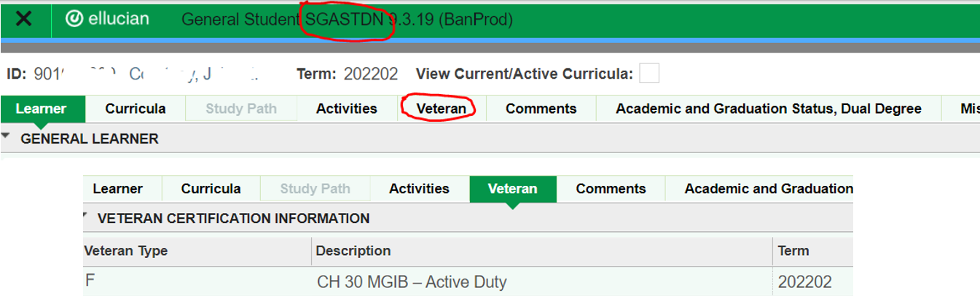
SGASTDN screen: VA Benefit Code
Notes:
To check if a student is using VA benefits for the semester prior go to the SGASTDN screen and check the code under “VETERAN” tab.
NOTE: there will only be a code entered if the student is a continuing student. New students – those who have not registered and never certified enrollment to the VA – will not have a code under the Veteran tab.

Slide 5
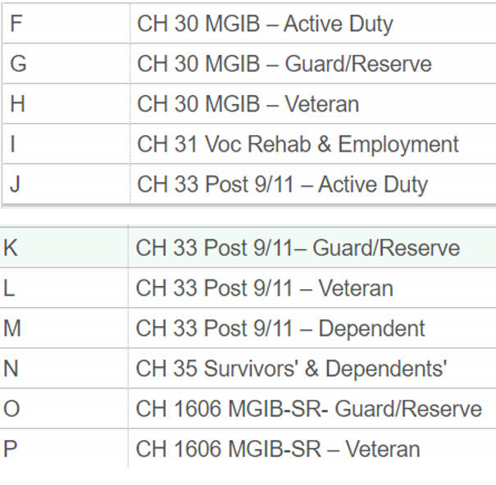

Codes you might see under the SGASTDN Veteran tab
Notes:
You do not need to know the differences between all of these designations.
This is just to illustrate the various codes we use to identify students using VA education benefits.

Slide 6
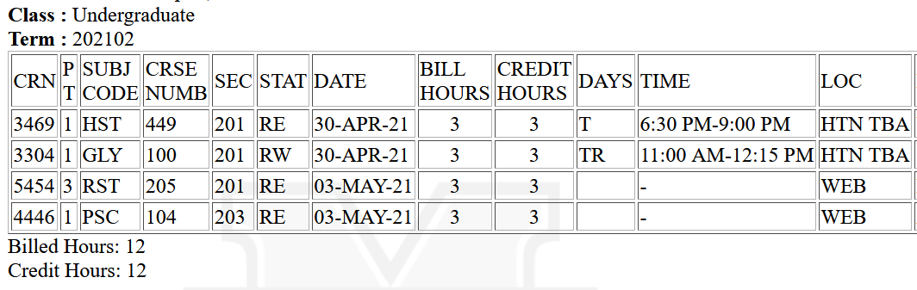

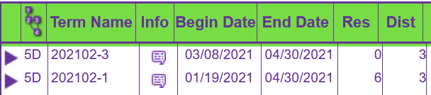
When are 12 credit hours not full-time?
When it is VA!
Notes:
12 credit hours is full time for Marshall and for financial aid.
But not necessarily for VA.
A part of term course, in this example we have a 2nd 8-weeks course, means the student will be certified for 9 credit hours from the start of the semester (January) to the end (April).
As well, 3 credit hours is certified starting in March when the 2nd 8-week courses begin, with an end date in April.
In this example, the VA will process the student at less than full time (three-quarter enrollment) until the second 8-week course begins.

Slide 7
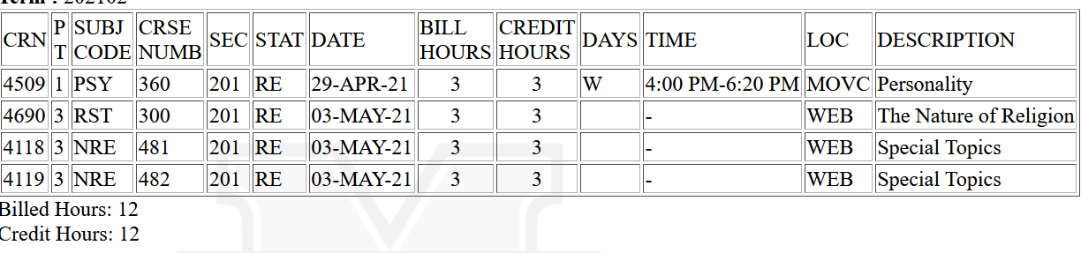
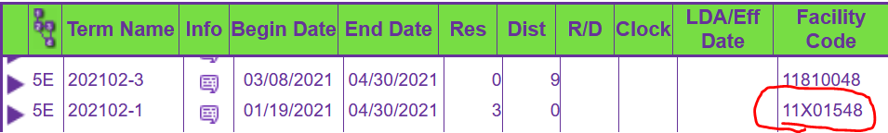
Notes:
In this example, we also have part of term courses.
The VA requires that we certify these based on the begin and end date.
This student will be full time only during the second 8 –weeks when the 9 hours of web-based courses are in session.
However, note that the full semester course, certified separately based on begin and end dates, also is certified under a different facility code.
VA requires courses to be certified based on their location.
This means that a student could be enrolled full time (for Marshall and financial aid) but for VA, they are part time for part of the semester, as well as, certified at “two different” facilities.

Slide 8
Withdraws, Backdated Withdraws - Issues
Withdrawing below full-time for full semester or part of term:
  Student may owe money:
    To VA for monthly stipend
    To VA for book stipend (CH 33)
    To MU for tuition (CH 33)
  Marshall may owe money:
    VA requires MU to return tuition for chapter 33 student who reduces below full time.
Notes:
When a student reduces below full-time, they will likely owe money to the VA and possibly to Marshall.
Again, even if they drop one 3 credit hour course and add another 3 credit hour course, the VA may see that as a reduction in one semester, and a certification of a new semester (assuming it is a part of term course after the adjustment period).

Slide 9
Withdraws, Backdated Withdraws – Issues cont’d
Backdated Withdrawal:
  Student may owe VA and/or MU
  MU may owe VA
  Can be a compliance issue if the “effective date” of withdraw is more than 30 days prior
  A withdraw and addition of class for part of term or extension campus creates same debt for student and/or Marshall as just a withdraw.
Notes:
Backdated withdrawals: not saying they aren’t allowed, just that they are problematic.

Slide 10
Prior Credit Evaluation
Prior credit must be evaluated and awarded:
  If student transfers from another institution or from one major to another.
  Example: FYS is generally required unless student transfers in 30 credit hours. Then, FYS is no longer applicable and can result in debt for student and/or university.
  Joint Services Transcripts: Military course work translated to civilian terminology.
    Sample transcript online: https://www.acenet.edu/Documents/Army-JST-Sample.pdf
    Student should request a free copy to show to advisor.
    The JTS will be applied after student completes 12 semester hours at Marshall with a cumulative GPA of 2.0 or higher.
Notes:
If a student will be transferring credit to Marshall, please be careful with basic courses such as FYS. This course may get bumped to “non-applicable” if enough transfer credits are brought in.
Joint Services Transcript – I encourage students to get a copy to show to their advisor. If they will receive credit, say for First Aid because they were a medic in the military, then they should avoid taking First Aid until these military credits are applied.
Military Credits are used in calculating the 60th attempted credit hour so typically they do not have D/F repeat courses.

Slide 11
Major, Minor, Matriculation: Oh My!
Double Major? Yes!
Courses toward a minor? No!
  (Unless degree requires a minor.)
Concentrations and Areas of Emphasis? Yes!
Undecided? Yes – until Junior status.
  (May only certify general education courses and pre-requisites required for entering the degree).
Non-degree? Yes – for two semesters only
  (May only certify general education courses and pre-requisites required for matriculation).
Notes:
They can:
Double Major
Add a concentration/emphasis
They can be “undecided” through their sophomore year (then they must declare a major)
They can be non-degree (University College) for only two semesters for VA (yes, Marshall allows three but VA only allows two). Only general education courses can be certified (those which transfer to any major at Marshall) while undecided or non-degree.
Courses toward a minor cannot be certified to the VA.
Exception:
Students earn minors by default such as in science when they have so much Chemistry they earn a minor in Chemistry by default.
Elective hours: no reason they cannot get a minor using their elective hours.

Slide 12
VA Beneficiaries – Priority Registration
It’s the Law!
  Only for veterans using VA education benefits in the current semester, and other students using VA education benefits in the current semester.
Notes:
Often billed as priority registration for “Veterans” it is not.
This is required for students currently using VA education benefits and their enrollment is certified to the VA in the current semester.
They get priority for the next semester registration.

Slide 13

Contact Information
https://www.marshall.edu/registrar/veterans
Old Main, 113
Lora Varney , School Certifying Official (SCO)
  varney40@marshall.edu
  304-696-2254

Slide 14

Questions?
Notes:
P

