Slide 1

Advising training
With Jean Ann Bevans, Associate Director of the Financial Aid Office

Slide 2
Financial Aid Satisfactory Academic Progress (SAP)
Term used to define successful completion of degree requirement to maintain eligibility for federal and state (and some institutional) financial aid programs.
SAP evaluation for undergraduate students occurs at the conclusion of each payment period, which is at the end of the fall semester, spring semester, and summer terms.
Visit www.marshall.edu/fasap to review SAP Policies, Appeal Forms, deadlines

Slide 3
SAP Requirements
Qualitative – 2.0 MU and overall GPA
Quantitative – complete 67% of coursework attempted
Maximum Timeframe – not attempt 150% or more of coursework needed to complete program (typically 180 credit hours)
Not be on academic probation
Not be on academic suspension

Slide 4
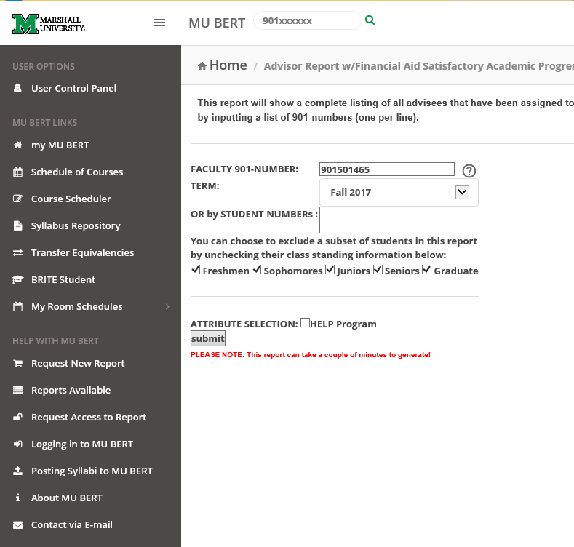
FA SAP MU BERT tool for Advisors - https://mubert.marshall.edu/

Slide 5
Procedures for Appeal
FAFSA must be filed; Cannot be in student loan default or owe a repayment of Title IV (federal) student aid funds
Explain and (document) reason for failure
Provide a detailed explanation of what has changed that will now allow the student to comply with SAP, a statement of academic objects, and a corrective action plan
SAP Appeals are submitted through Dynamic Forms and are found at: https://www.marshall.edu/sfa/forms-applications/

Slide 6
Financial Aid Academic Plan
Must earn at least a 2.1 GPA for the semester/term the student is placed on Financial Aid Probation and
Must successfully complete 80% of the coursework attempted (100% if student failed maximum timeframe measure)

Slide 7
Complete Withdrawal of Classes and Financial Aid Impact
Prior to withdrawal, highly recommend contacting Financial Aid to review impact
Satisfactory Academic Progress must be reviewed to give heads up on appeal
Future aid effected due to renewal requirements not being met
Students with loans start to use up loan grace period upon complete withdrawal
Students with federal aid will go through Return to Title IV Process

Slide 8
Return to Title IV Process
Calculation that is done to determine how much federal (and state aid if applicable) aid must be returned
Based of date of withdrawal and charges by university
Most students tend to owe at least something

Slide 9
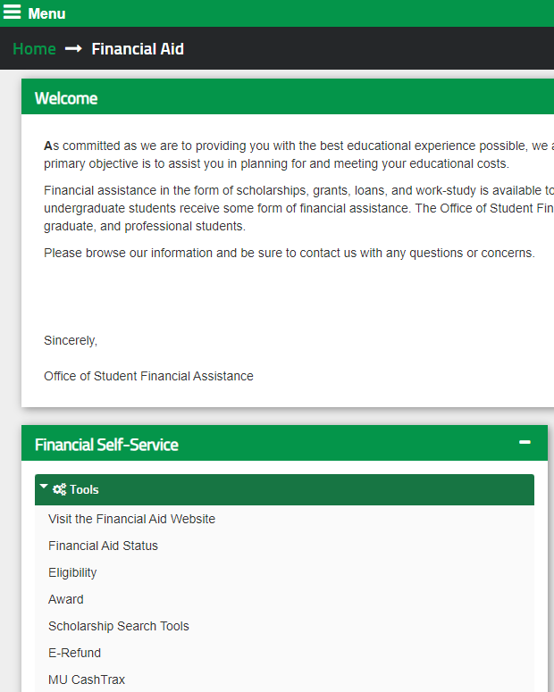
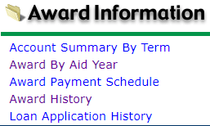
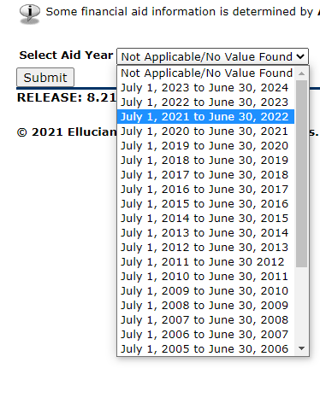
Merit Scholarship Renewal
(Student View)

Slide 10
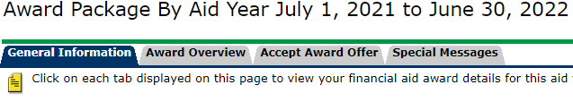
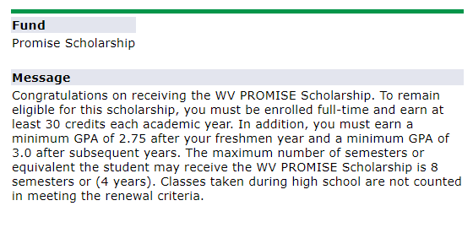
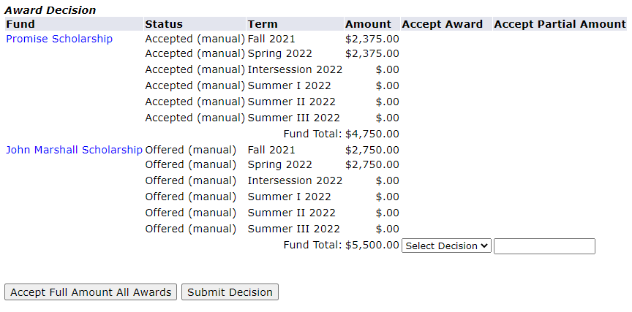
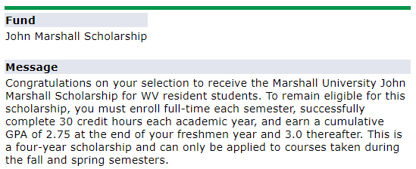
Merit Scholarship Renewal
(Student View) Part 2

Slide 11
Course Program of Study (CPOS)
In order to be eligible for Federal and State aid, courses that students are taking must be applicable towards their Program of Study
Degree works must be maintained and updated
CPOS process runs nightly to correct issues from previous day, reflecting on Financial Aid’s side the next day
CPOS cutoff date is after first week of classes (CPOS stops running automatically for all students)
Repeat Coursework

Slide 12
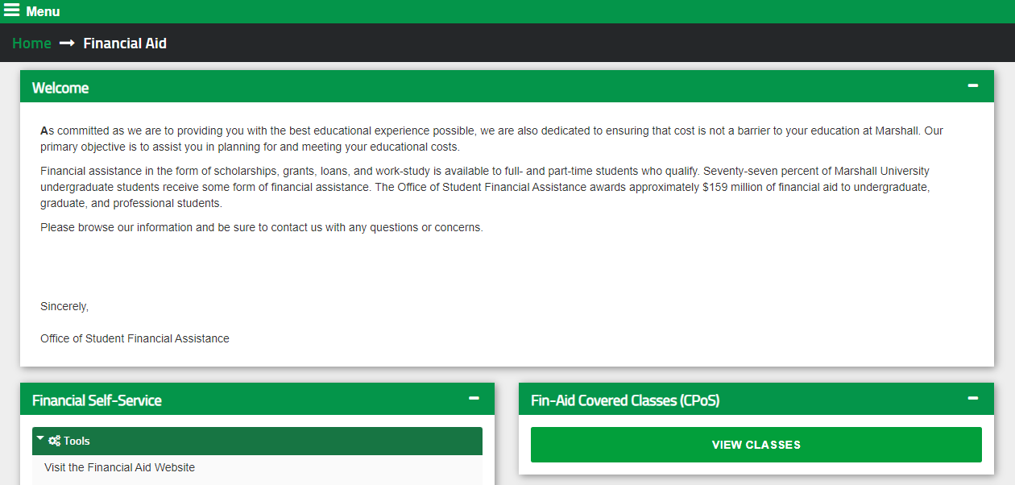
CPOS Student View (Launched Dec. 6th)

Slide 13
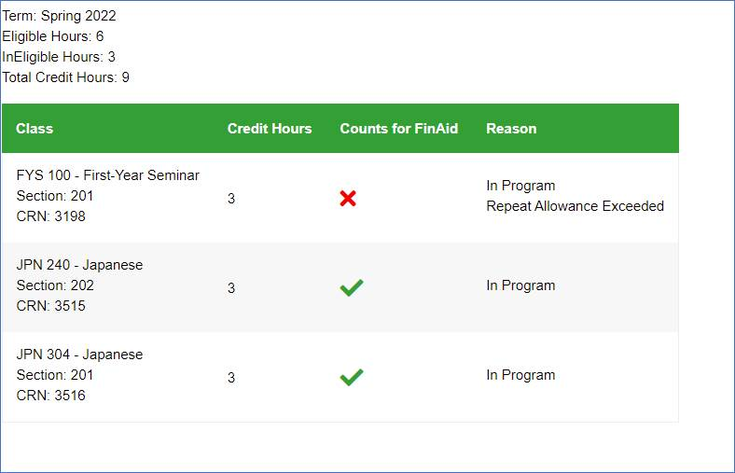
CPOS Student View Part 2

Slide 14
State CPOS
State aid falls under the same rules as federal aid
Certain exceptions can be made to still receive state aid by completing an HEPC Appeal Form
Located at: https://www.cfwvconnect.com/appeal/
Initial review by Financial Aid, then sent to Advising, back to Financial Aid, to state for approval, then back to Financial Aid for processing
Hopeful to be in house in a couple years

Slide 15
HEERF and Cares Funding
All CARES funding was awarded previous years
HEERF awards were finalized the beginning of Fall semester
Opportunities to appeal for additional funding was given
There will be a Spring award for students after classes begin
Funds will be used very quickly

Slide 16
Questions?

